Slide 1

Session 7 – Python
Brief Intro to Machine Learning with Scikit Learn
Doug Bowman

Slide 2
Overview
Overview
  Intro Example Code
  Concepts and Definitions
  General Model Types
  Linear Models
  Dataset Preparation
  Evaluating Accuracy
  Ensemble Methods
  Tuning
  Bringing it All Together – Model Selection

Slide 3
Overview
Intro Example Code
  Build and run the first model built with the iris data set in ‘Machine Learning with Scikit-Learn.py’

Slide 4
Concepts and Definitions
Machine Learning
  The use of a model that learns from data to increase the predictive ability of an algorithm.
  Data by itself is not machine learning, since no learning can occur without assimilation of the data towards prediction.
  Data that cannot increase predictive capabilities of an algorithm is not machine learning—no learning occurs in this situation.

Slide 5
Concepts and Definitions
Trainers
  The mathematical equation, set of equations, and/or algorithm that is used to build a model.
  Examples:
    Classifiers
    Regressors

Slide 6
Concepts and Definitions
Classifier
  The trainers used to build models to predict outcomes for classification problems.
  For problems where we are trying to categorize something.
    i.e. trying to determine what kind of fruit something is.
    Trying to determine what kind of animal is in a picture.
  This is the scaffolding for our model.

Slide 7
Concepts and Definitions
Regressor
  The trainers used to build models that predict outcomes for regression problems.
  Problems were we are predicting a quantity within a range of values.
    i.e. Predicting the median household income in the future.
    How much thrust a new engine model will have.
  This is the scaffolding for our model.

Slide 8
Concepts and Definitions
Regressor
  In general, regressors predict by creating a function.
  For linear regressors, the function is similar to the following:
    Y_{predict} = w₁*f₁ + w₂*f₂ + w₃*f₃ + … + w_{n}*f_{n} + b + r
      Y_{predict} = predicted value for a given sample
      w = weights
      f = feature value
      n = number of features
      b = intercept of linear line
      r = regularization parameter
Notes:
Regularization parameter is used to adjust how the weight factors are optimized.
Different models either don’t use regularization, or use different methods for regularization.

Slide 9
Concepts and Definitions
Model
  The construct that is/will be trained and filled with data.
  This is what will tell us what the “answer” is.

Slide 10
Concepts and Definitions
Trainer vs Model
  The trainer is the template used to create a model.
  The model is what actually contains the data, where the trainer tells the model what to do with the data.
  The trainer is like a class, where the model is like an object.

Slide 11
Concepts and Definitions
Experience
  The incorporated data used to increase the effectiveness of the model’s predictions.

Slide 12
Concepts and Definitions
Feature
  A description of a set of like-data.
  This is usually represented as a column in a data table.
  Examples:
    Color of a fruit
    Length of a fruit
    Width of a fruit

Slide 13
Concepts and Definitions
Feature
  Examples continued:
    Past convictions when estimating if a person will commit a crime
    Family members with convictions when estimating if a person will commit a crime
    Convictions of local living area when estimating if a person will commit a crime

Slide 14
Concepts and Definitions
Sample
  A single set of data, or a data point.
  This is usually a row in a data table.

Slide 15
Concepts and Definitions
Label (Classification Problems)
  The name associated with a data point (row) for classification problems.
  This is generally the thing we are trying to predict.
  A.k.a. target
  Examples:
    ‘Apple’ if we are trying to predict a piece of fruit.
    ‘Yes/true’ if we are predicting if someone will commit a crime.

Slide 16
Concepts and Definitions
Training Data
  Data that is used to build our model.
  Data that is not used to test the accuracy of our model.

Slide 17
Concepts and Definitions
Test Data
  Data that is used to test the accuracy of a trained model.
  Separate from training data.

Slide 18
Concepts and Definitions
Overfitting
  Training a model so closely to training data that it does not model test data/other data as accurately.
  Usually indicated by a high accuracy on the training data, and an unreasonably low accuracy on the test data.
    The model will not be able to extrapolate or interpolate well.

Slide 19
Concepts and Definitions
Overfitting
  Possible Causes:
    Test data that is not sufficiently representative of the entire data spectrum.
    Tuning parameters adjusted too tightly to test data
    Extrapolating when only interpolating is relevant

Slide 20
Concepts and Definitions
Underfitting
  Training model not tight enough to test data and training data.
  Indicated by unreasonably low training and test data accuracy.
  Possible Causes:
    Tuning parameters not tuned enough.
    Incorrect features, or insufficient number of features, selected.

Slide 21
Concepts and Definitions
Decision Boundary
  The boundary between different categories in a classification problem.
  This is generated by the model.

Slide 22
General Model Types
Supervised
  Machine learning model is given a set of data to build experience with.
  Data is given with features, and an algorithm is given to the model on how to best categorize and group the data.

Slide 23
General Model Types
Unsupervised
  The model determines the data for itself, and builds the model accordingly.
  Features and grouping data is done by the algorithm.

Slide 24
General Model Types
Reinforcement
  The algorithm “learns” from making mistakes.
  There must be some sort of way to tell the algorithm when it makes a correction in the right direction, and a way to tell the algorithm a correction was made in the wrong direction.
  Initially, the model built is very inaccurate, but gets better with time.

Slide 25
General Model Types
This part of the Python course will focus on supervised learning, as this is all I know.

Slide 26
General Workflow
Get data
Build model
Evaluate predictive capabilities
Rebuild model, if needed
Predict real-world outcomes

Slide 27
General Workflow
Get Data
  Get set of data about what we wish to predict.
  Include the labels.

Slide 28
General Workflow
Build Model
  Select an appropriate classifier.
  The model should be trained with a majority of the data we gathered, say with 75% of the data.
  The other 25% can be used to test how good our model can predict.

Slide 29
General Workflow
Evaluate Predictive Capabilities
  The model needs to be evaluated for acceptable predictive capabilities to ensure our predictions will have a high degree of correctness.
  This is usually done using a sequestered set of data we use for testing.

Slide 30
General Workflow
Evaluate Predictive Capabilities
  There is no such thing as 100% accuracy unless you have toy data, or a completely defined system that does not need machine learning.
  If we get 100% accuracy, and the above are not true, we have most likely over-fitted our model, possibly by using training data as test data.
    Leads to inaccurate predictions on new data without known labels

Slide 31
General Workflow
Evaluate Predictive Capabilities
  Accuracy is not the only way to measure the predictive capabilities of a model.

Slide 32
General Workflow
Rebuild Model
  If the model isn’t suitable enough, we rebuild the model with more/better data, more tuned parameters, or using a different trainer.

Slide 33
General Workflow
Predict real-world outcomes
  Once we are happy with the predictive capability of our model, the model can be used to predict real-world outcomes that are unknown.

Slide 34
Linear Models
List of some types we will Cover
  Linear Classifiers
    K-Nearest Neighbors
    Decision Tree
    Logistic Regression
      Misleading name
    Support Vector Classifier

Slide 35
Linear Models
List of some types we will Cover
  Linear Regressors
    K-Nearest Neighbors
    Linear Regression
    Ridge Regression
    LASSO Regression
    Decision Tree
    Forest
    Gradient-Boosted Forest

Slide 36
Linear Models
Models differ in:
  How they create a decision boundary
  How they model accuracy
  Tuning/regularization they use

Slide 37
Linear Models - Classifiers
Classifiers
  Tries to predict a specific thing.
  Is either right or wrong for each prediction.
  Examples
    Predicting a type of fruit.
    Predicting a type of animal.
    Predicting a breed of dog.

Slide 38
Linear Models - Classifiers
K-Nearest Neighbors
  Predicts outcome by finding the closest matching data point neighbor(s) to the target point.
  When multiple neighbors are used, the classification with the most neighbors is what the target point is classified as.

Slide 39
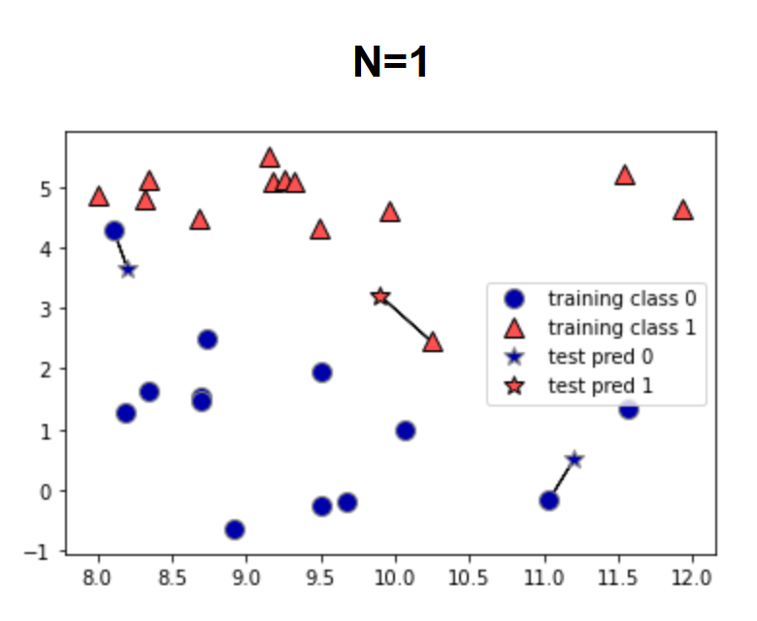
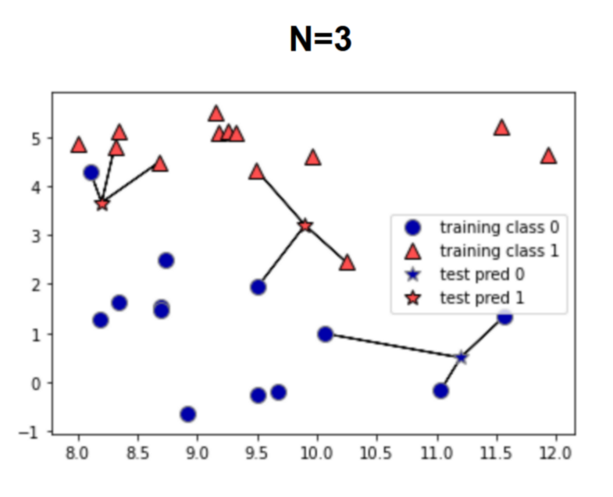
Linear Models - Classifiers
K-Nearest Neighbors
  Graphs below show decision, generated in source (1). The stars are the test data, and the model is predicting whether they are blue or red.

Slide 40
Linear Models - Classifiers
In-Class Exercise
  Run the classifier example with k-nearest neighbors and optimize based on number of neighbors.
    Use the .score() return value as your accuracy metric.

Slide 41
Linear Models - Classifiers
Decision Tree
  Builds a series of if-statements to classify test points.
  Boundaries around classifications are built based on the data.
  The number of if statement groups, or boundaries created, is known as the depth.

Slide 42
Linear Models - Classifiers
Decision Tree
  See file “./Session 7 – Python/Instructional Material/Class Examples/Scikit-Learn/decision_tree_graph.html“ for a representation of how the decision tree classifies from data.
    Generated from iris data set
    Code can be found in class example code under the decision tree section

Slide 43
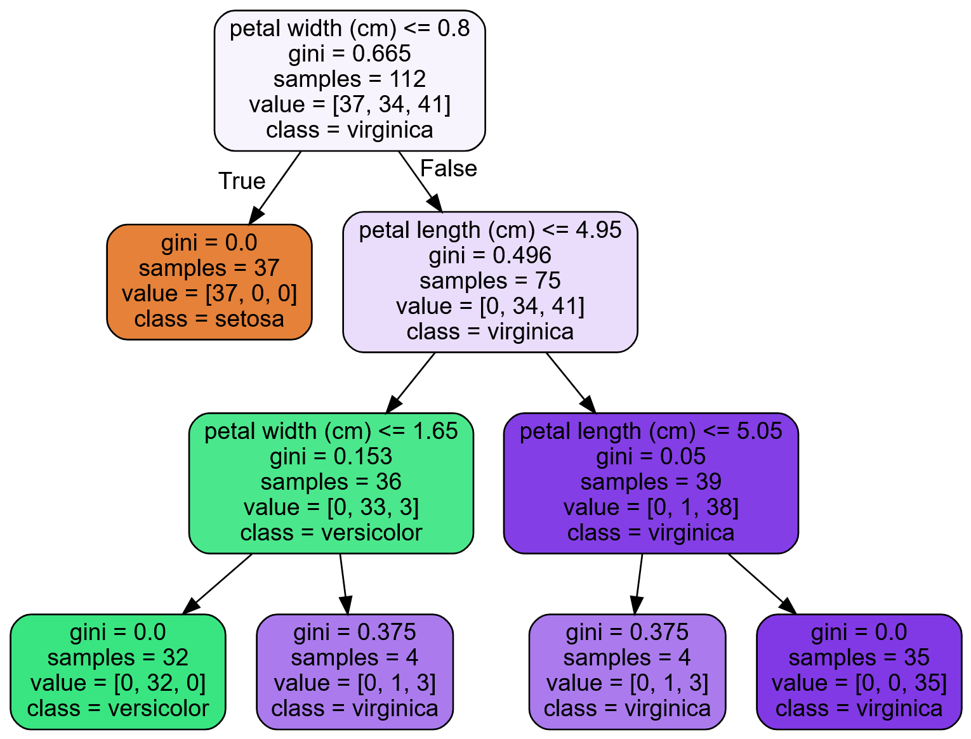
Linear Models - Classifiers
Decision Tree

Slide 44
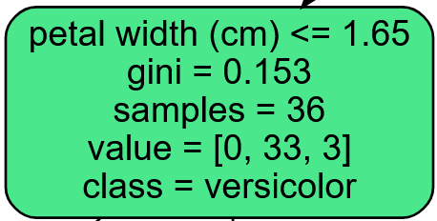
Linear Models - Classifiers
Decision Tree
  Attributes
    First line is the decision criteria for the children notes of the node the condition appears in.

Slide 45
Linear Models - Classifiers
Decision Tree
  Attributes
    Gini – A measure of the impurity of the node. 0 means all predictions are the same class, 1 means an infinite number of samples are classified in an infinite number of labels.

Slide 46
Linear Models - Classifiers
Decision Tree
  Attributes
    Gini
      = 1 -
      is the ratio of the predicted class to all samples of the kth class for the ith node.
      Closer to zero means most of the predicted labels are one class.
      Closer to one means the predicted labels are across more classes.

Slide 47
Linear Models - Classifiers
Decision Tree
  Attributes
    Gini
      The gini score is used in a cost function to determine which feature is used to create the decision boundary/condition for each node.

Slide 48
Linear Models - Classifiers
Decision Tree
  Attributes
    Samples – The number of training sets used to predict the current node.
    Value – The predicted classes with the given samples. This is in the order of the dataset label names.

Slide 49
Linear Models - Classifiers
Decision Tree
  Attributes
    Class – The predicted label of this node.

Slide 50
Linear Models - Classifiers
Decision Tree
  Tends to overfit the data.
  Can control this (regularize) by modifying the following parameters:
    max_depth
      The maximum depth the tree can go do.
    max_leaf_nodes
      Maximum number of leaves allowed in the model.
    max_features
      The number of features used in determining a node split.
Notes:
max_depth – The maximum number of node levels to generate.
max_leaf_nodes – The maximum number of leaves that can occur in the tree.
max_features – Maximum number of features that are evaluated for splitting each node.
min_samples_split – Minimum number of samples a node must have before it can split into another depth.
min_samples_leaf – The minimum number of samples a leaf node must have to exist.
min_weight_fraction_leaf – Same as min_samples_leaf, but uses a weighted fraction instead of sample count.

Slide 51
Linear Models - Classifiers
Decision Tree
  Tends to overfit the data.
  Can control this (regularize) by modifying the following parameters:
    min_samples_split
      Minimum number of samples in a node before a split can occur.
    min_samples_leaf
      Minimum number of samples needed in each produced leaf.
    min_weight_fraction_leaf
      The minimum weight with respect to the total weight a leaf can have in order for the leaf to exist.
Notes:
max_depth – The maximum number of node levels to generate.
max_leaf_nodes – The maximum number of leaves that can occur in the tree.
max_features – Maximum number of features that are evaluated for splitting each node.
min_samples_split – Minimum number of samples a node must have before it can split into another depth.
min_samples_leaf – The minimum number of samples a leaf node must have to exist.
min_weight_fraction_leaf – Same as min_samples_leaf, but uses a weighted fraction instead of sample count.

Slide 52
Linear Models - Classifiers
Decision Tree
  Sensitive to data
    Removing/adding one data point can drastically change the decision boundaries.
Notes:
max_depth – The maximum number of node levels to generate.
max_leaf_nodes – The maximum number of leaves that can occur in the tree.
max_features – Maximum number of features that are evaluated for splitting each node.
min_samples_split – Minimum number of samples a node must have before it can split into another depth.
min_samples_leaf – The minimum number of samples a leaf node must have to exist.
min_weight_fraction_leaf – Same as min_samples_leaf, but uses a weighted fraction instead of sample count.

Slide 53
Linear Models - Classifiers
Decision Tree
  Sensitive to data orientation
    This applies more for regression.
    Boundaries for decision trees are orthogonal (i.e. they are vertical or lateral, but not angled).
    Rotating the data points on a graph can drastically change the decision boundaries.
Notes:
max_depth – The maximum number of node levels to generate.
max_leaf_nodes – The maximum number of leaves that can occur in the tree.
max_features – Maximum number of features that are evaluated for splitting each node.
min_samples_split – Minimum number of samples a node must have before it can split into another depth.
min_samples_leaf – The minimum number of samples a leaf node must have to exist.
min_weight_fraction_leaf – Same as min_samples_leaf, but uses a weighted fraction instead of sample count.

Slide 54

Linear Models - Classifiers
In-Class Exercise
  Run the decision tree classifier example. Play with the depth to build accuracy, using at least 1-6 depths. Does accuracy continue to increase with depth? Why or why not?

Slide 55
Linear Models - Classifiers
Logistic Regression
  Used for classification, even though the name has “regression” in it.
  Works similar to other linear regressors, using a linear equation to generate decision boundaries/predict the label of the data point.

Slide 56
Linear Models - Classifiers
Logistic Regression
  Estimates probability that a sample belongs to a classification or not.
  If the probability is over 50%, then the sample is the label.
  Since this trainer can only tell if the sample either is the label or not, this trainer can only be used for binary classification.

Slide 57
Linear Models - Classifiers
Logistic Regression
  Uses regularization parameter c
  Logistic regression defaults to using L2 regularization, but L1 can be chosen.
    More will be discussed on regularization in the following section.

Slide 58
Linear Models - Classifiers
Logistic Regression
  High c value
    Less regularization
    Model tries to fit training set more closely
    Each feature is stressed in the weighting

Slide 59
Linear Models - Classifiers
Logistic Regression
  Low c value
    More regularization
    Each weight is brought closer to zero, which minimizes the importance of each individual feature on the overall label prediction.
    Model stresses generalization, and adjusts to hit the majority of points more than each one
      Too much regularization can cause the model to miss points that are close to both categories.

Slide 60
Linear Models - Classifiers
In-class Example
  Logistic Regression

Slide 61
Linear Models - Classifiers
In-Class Exercise
  Optimize c for logistic regression.

Slide 62
Linear Models - Classifiers
Regularization
  Trainers can use either a cost function to determine the weights of each feature, or a utility function.
    Cost functions should be minimized to determine weights.
    Utility functions should be maximized to determine weights.
  For this class, we will be using cost functions, such as Mean Squared Error or Ordinary Least Squares

Slide 63
Linear Models - Classifiers
Regularization
  A general cost function may look something like the following (Mean Squared Error):
    Cost = 1/n*[(Ŷ₁-Y₁)² + (Ŷ₂-Y₂)² + (Ŷ₃-Y₃)² + … + (Ŷ_{n}-Y_{n})²]
      Ŷ = predicted label
      Y = actual label
      n = number of samples
      w is the determined weight
      x is the feature value
      m is the number of features

Slide 64
Linear Models - Classifiers
Regularization
  This cost function is used to calculate the weight
    Our machine learning model will use specific parameters, along with adjusting the weights of each feature, to minimize the cost function.
      Learning rate
      Predicted outcomes/labels
      Actual outcomes/labels
    Once the cost function is minimized, the feature weights have been determined and our model is trained.

Slide 65
Linear Models - Classifiers
Regularization
  Regularization adds an additional r penalty to the cost function, driving the weights closer to 0.
    Cost = 1/n*[(Ŷ₁-Y₁)² + (Ŷ₂-Y₂)² + (Ŷ₃-Y₃)² + … + (Ŷ_{n}-Y_{n})²] + r
      Ŷ = predicted label
      Y = actual label
      n = number of samples
      r = regularization penalty to cost function
      w is the determined weight
      x is the feature value
      m is the number of features

Slide 66
Linear Models - Classifiers
Regularization
  Alternative notation
    J = + r
      J = Cost Function
      Ŷ = predicted label
      Y = actual label
      n = number of samples
      r = regularization penalty to cost function
      i = Sample index parameter

Slide 67
Linear Models - Classifiers
Regularization
  Alternative notation
      Ŷ = Predicted label for the given sample
      m = Number of features
      w = Weight values
      x = Feature values
      k = Feature index parameter

Slide 68
Linear Models - Classifiers
Regularization
  L1 Regularization
    r = α
      α is a hyperparameter used to adjust how fast the weights change (in the case of logistic regression, this is the c parameter)
        α = 1/c
      w is the weight of a feature
    Can cause the weights for features to go to 0

Slide 69
Linear Models - Classifiers
Regularization
  L2 Regularization:
    r = α ²
      α is a hyperparameter used to adjust how fast the weights change
        This is the c parameter in logistic regression
        α = 1/c
      w is the weight of a feature
    Weights for features cannot go to zero, but can get as close as needed

Slide 70
Linear Models - Classifiers
Regularization
  The general effect of regularization is to flatten a curve between all the data points.
    Causes the model to better generalize to the data.

Slide 71
Linear Models - Classifiers
Regularization
  The cost function can change, and regularization can still be applied.
  We used MSE as an example for this section:
    J = + r
  Ordinary Least Squares is another cost function that can be used:
    J = + r

Slide 72
Linear Models - Classifiers
Support Vector Machine (SVM) Classifiers
  Useful for small, complex datasets
  Types
    Linear
      Create boundary line by maximizing distance between two classes.
    Nonlinear
      Use feature engineering to generate more features

Slide 73
Linear Models - Classifiers
Linear SVM
  Attempts to create decision boundaries that maximize the space between the two closest samples.

Slide 74
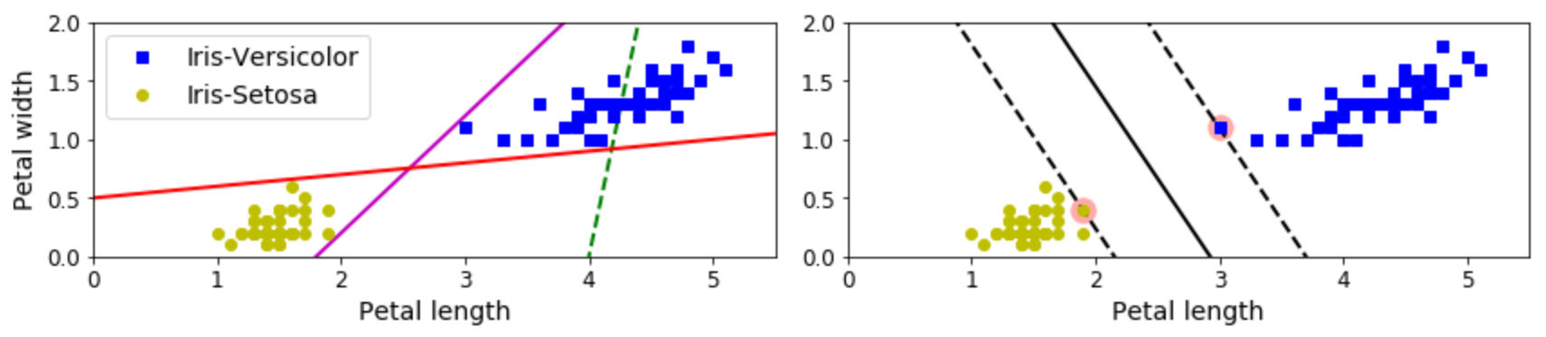
Linear Models - Classifiers
Linear SVM
  The left figure below shows individual linear classifier boundaries for multiple models
  The right figure shows the boundary for a linear SVM.
(4)

Slide 75
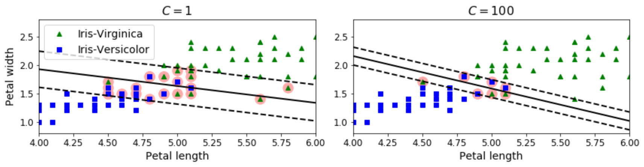
Linear Models - Classifiers
Linear SVM
  Support Vectors
    The points that generate the margin lines.
  Margin Violations
    Data points that are within the margins (dashed lines), even if they are on the correct side of the boundary.
(4)

Slide 76
Linear Models - Classifiers
Linear SVM
  Regularization
    Linear SVM’s use the c hyperparameter
    The c value changes the width of the margins from the boundary condition.
    Smaller c values increase the margins, which generalizes more

Slide 77
Linear Models - Classifiers
Linear SVM
  Regularization
    Smaller c values
      Increase the margins
      More generalized
      More margin violations
    Larger c values
      Smaller margins
      Fewer margin violations
      Less generalization
      Higher chance of overfitting to training data

Slide 78
Linear Models - Classifiers
Linear SVM
  Regularization
(4)

Slide 79
Linear Models - Classifiers
In-class Example
  Linear SVM

Slide 80
Linear Models - Classifiers
In-Class Exercise
  Use LinearSVM, adjusting C to see how this affects accuracy and generalization.

Slide 81
Linear Models - Classifiers
Nonlinear SVM
  Used when classes are not linearly separable.
  Multiple ways to deal with this.

Slide 82
Linear Models - Classifiers
Nonlinear SVM
  Feature Addition
    Adding more features can allow the data to be linearly separable.

Slide 83
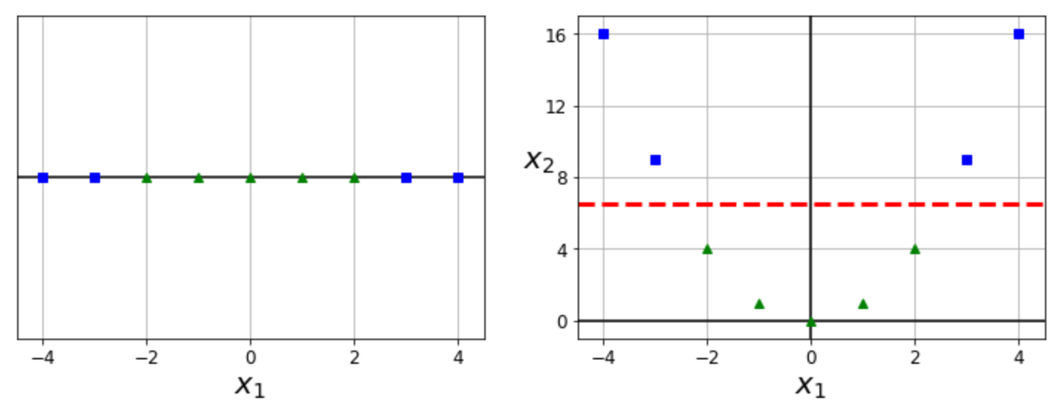
Linear Models - Classifiers
Nonlinear SVM
  Feature Addition
    The right figure results from creating a new parameter based on the squared value of the x₁ parameter.
(4)

Slide 84
Linear Models - Classifiers
Nonlinear SVM
  Feature Addition
    This new feature allows for a linearly separable boundary between the two classes.
(4)

Slide 85
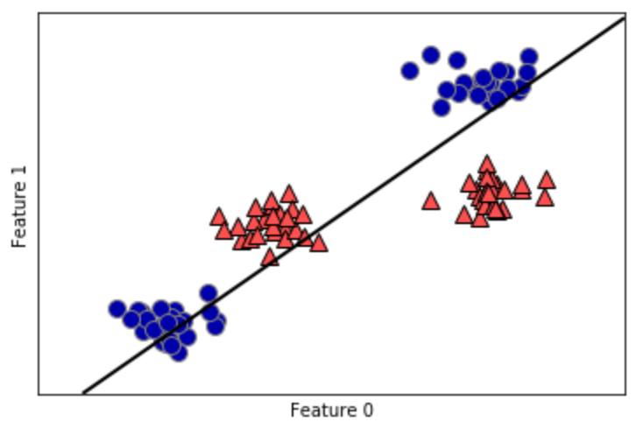
Linear Models - Classifiers
Nonlinear SVM
  Feature addition transforms this (see reference 1):
(1)

Slide 86
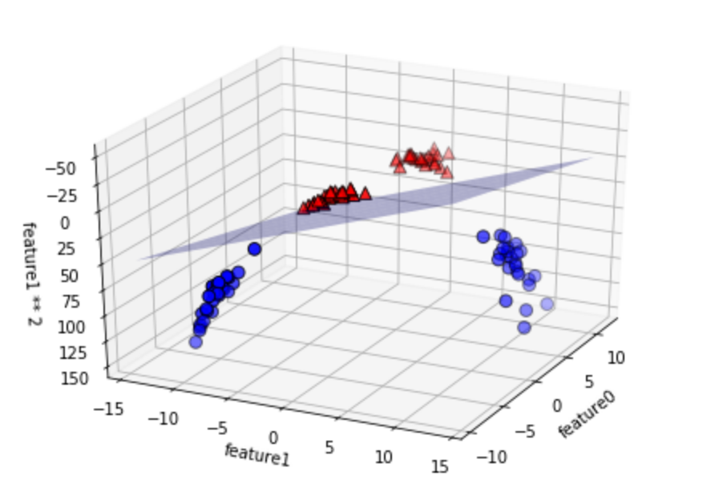
Linear Models - Classifiers
Nonlinear SVM
  To this (see reference 1):
(1)
Notes:
It is almost like the previous slide is showing a projection of this graph along just the feauture1-feature0 plane.

Slide 87
Linear Models - Classifiers
Nonlinear SVM
  Feature Addition
    Methods:
      Polynomial
      Similarity Function

Slide 88
Linear Models - Classifiers
Nonlinear SVM
  Feature Addition Using Polynomial Functions
    Addition of features using a polynomial function with another feature as an input.
    A polynomial function is of the form:
    The previous figures show graphical examples using polynomial functions.

Slide 89
Linear Models - Classifiers
Nonlinear SVM
  Feature Addition using Similarity Function
    A similarity function is used vs a polynomial function.
    The similarity function measures how much each feature data point resembles a user-specified landmark.
      The closer the data point is to a landmark, the higher the value from the similarity function.
      Can select as many feature data points to be landmarks as desired, but this increases the amount of data to predict from.
      The more landmarks chosen, the higher the linearity of the data since the number of dimensions increases.

Slide 90
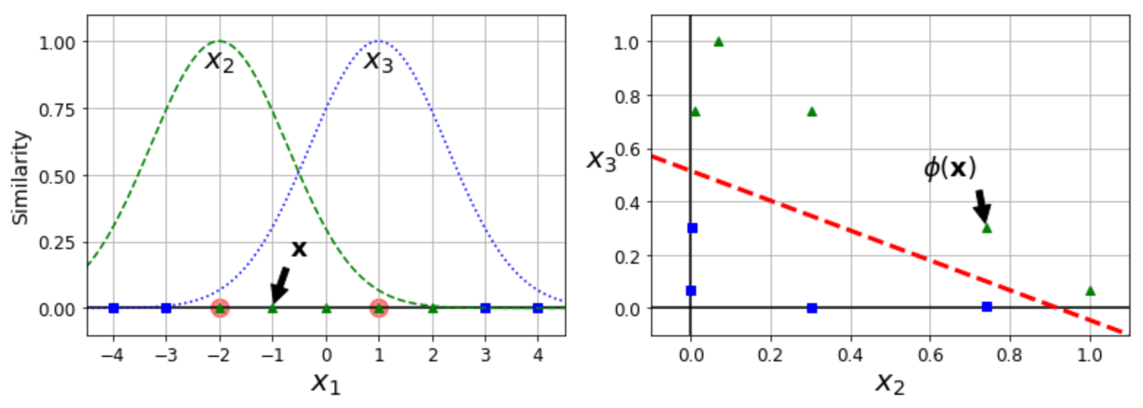
Linear Models - Classifiers
Nonlinear SVM
  Feature Addition using Similarity Function
    The following example uses the Gaussian Radial Basis Function as the similarity function, as an example.
(4)

Slide 91
Linear Models - Classifiers
Nonlinear SVM
  Feature Addition using Similarity Function
    The landmarks chosen here are -2 and 1.
(4)

Slide 92
Linear Models - Classifiers
Nonlinear SVM
  gamma (γ) hyperparameter
    Used for Gaussian RBF kernel
    Causes width of bell curves to tighten
    Causes decision boundary to wrap more tightly around the targeted class/landmarks.
    Acts like the hyperparameter c
    Higher values decrease generalization, and attempt to more exactly fit the data
    Lower values increase generalization.

Slide 93
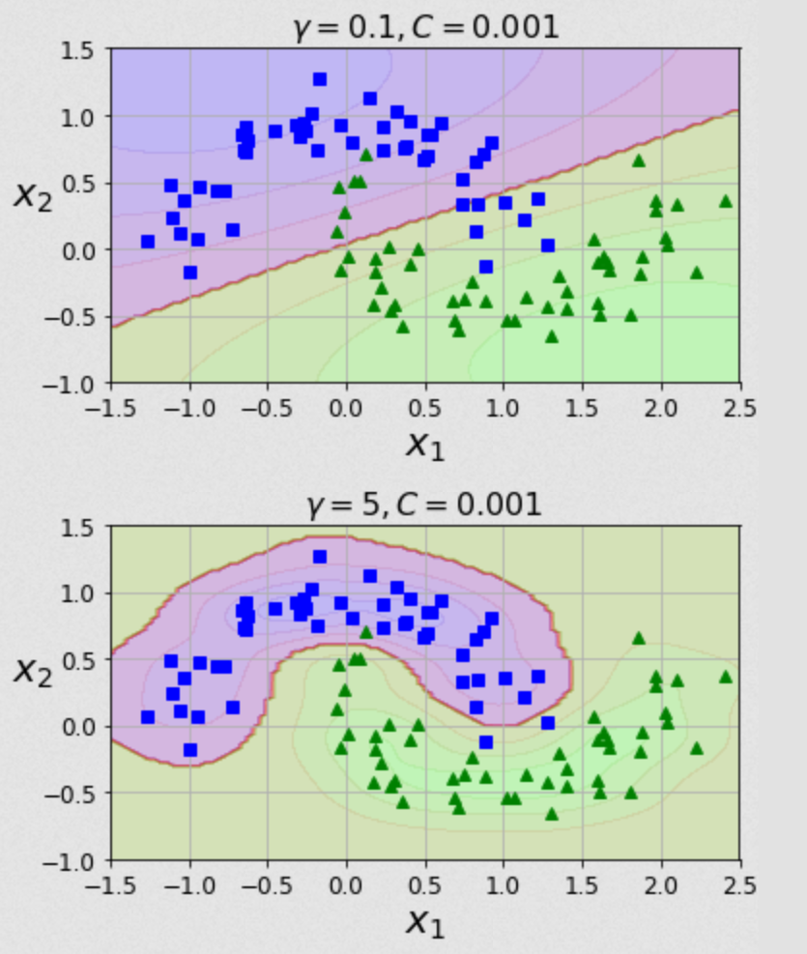
Linear Models - Classifiers
Nonlinear SVM
  gamma (γ)
hyperparameter
(4)

Slide 94
Linear Models - Classifiers
Nonlinear SVM
  Kernel Trick
    Adding more features can allow the data to be linearly separable, but also increases the amount of computational power needed.
    The kernel trick does some mathematical trickery to map the prediction function to a different space.
    Mapping the function to a different space allows a less computationally expensive calculation vs computing values for the function itself.
    This decreases the needed computational power.

Slide 95
Linear Models - Classifiers
Nonlinear SVM
  Kernel Trick
    Different kernels can be used, including for polynomial and similarity function methods covered above.
    See code for examples.

Slide 96
Linear Models - Classifiers
In-class Example
  Nonlinear SVM using feature addition
  Nonlinear SVM using kernels

Slide 97
Linear Models - Classifiers
In-Class Exercise
  Optimize the polynomial degree for nonlinear SVM using the polynomial kernel.
  Use the RBF kernel with the nonlinear SVM, adjusting gamma and C to see how they affect accuracy and generalization.

Slide 98
Linear Models - Regressors
Regressors
  Tries to predict an unbounded value as accurately as possible vs predicting a specific class.
  Creates a linear equation to predict outcomes:
    Y_{predict} = w₁*f₁ + w₂*f₂ + w₃*f₃ + … + w_{n}*f_{n} + b
      Y_{predict} = predicted value for given sample
      w = weights
      f = feature value
      b = intercept of linear line
      n = number of features
    A.k.a the prediction function.

Slide 99
Linear Models - Regressors
Regressors
  The models we train adjust the values of w_{x} and b.
  For functions with regularization, an additional hyperparameter is added to guide model convergence when generating the prediction function.
  Examples:
    Trying to predict median household income of an area.
    Trying to predict the value a stock will rise to.

Slide 100
Linear Models - Regressors
K-Nearest Neighbors Regression
  Similar to the classifier variant, the regressor picks the value that is closest to the most similar neighbor.
  Multiple neighbors are averaged together.
    Option to weight the average, such as weighting neighbors inversely to their distance from the point to predict.

Slide 101
Linear Models - Regressors
Linear Regression (Ordinary Least Squares)
  Attempts to minimize the mean squared error between the prediction and the target values.
  The error of this trainer is calculated by adding the squared differences between the predicted value with the actual target value.
  No regularization parameters to adjust the accuracy of this trainer.

Slide 102
Linear Models - Regressors
Linear Regression (Ordinary Least Squares)
  Cost = [(Ŷ₁-Y₁)² + (Ŷ₂-Y₂)² + (Ŷ₃-Y₃)² + … + (Ŷ_{n}-Y_{n})²] =
    Ŷ = predicted label
    Y = actual label
    n = number of samples
  =
    w is the determined weight
    x is the feature value
    m is the number of features

Slide 103
Linear Models - Regressors
In-Class Example – Linear Regression

Slide 104
Linear Models - Classifiers
In-Class Exercise
  Run a linear regression prediction on the Boston housing data set.

Slide 105
Linear Models - Regressors
Ridge Regression
  Uses a modified Ordinary Least Squares as the cost function to fit the data.
  Adds additional constraint of attempting to minimize the magnitude of the weight coefficients for each feature without eliminating the feature.

Slide 106
Linear Models - Regressors
Ridge Regression
  Each weight should be as close to zero as possible.
  Each feature will have as little affect on the prediction as possible.
  Note that the feature weights will not be exactly zero using this trainer, so each feature still affects the prediction.

Slide 107
Linear Models - Regressors
Ridge Regression
  Attempting to minimize the weight magnitudes is a form of regularization.
    Regularization is used to attempt to prevent overfitting.
  This trainer uses L2 regularization with OLS as the cost function
    The sum of the square of the weight coefficient for each feature is used as a penalty term in determining model accuracy.

Slide 108
Linear Models - Classifiers
Ridge Regression
  Ordinary Least Squares with Regularization
    Cost =
      Ŷ = predicted label
      Y = actual label
      n = number of samples
      i = feature index
      j = weight index
      α = regularization hyperparameter, must be >=0
      m = number of features
      w = determined weight

Slide 109
Linear Models - Classifiers
Ridge Regression
  Ordinary Least Squares with Regularization
      w is the determined weight
      x is the feature value
      m is the number of features

Slide 110
Linear Models - Regressors
Ridge Regression
  For this Scikit-Learn trainer, alpha is the hyperparameter used for regularization.
  Increasing alpha moves each feature’s weight more towards zero.
    This may help make the model more generalized, which will help overfitting.
    This will decrease training set performance.

Slide 111
Linear Models - Regressors
Ridge Regression
  Increasing alpha more and more will not necessarily make the model more predictive.
  Alpha will need tuned for an optimal model.

Slide 112
Linear Models - Regressors
In-Class Example – Ridge Regression

Slide 113
Linear Models - Regressors
In-Class Exercise
  Run the example with ridge regression, attempting to optimize the test prediction data set by adjusting alpha.

Slide 114
Linear Models - Regressors
LASSO Regression
  Least Absolute Shrinkage and Selection Operator
  Similar to ridge regression, uses a modified Ordinary Least Squares algorithm as the cost function.
  Attempts to make each weight close to zero.
  In this trainer, a weight value can be zero, so that a feature will not affect the prediction.

Slide 115
Linear Models - Regressors
LASSO Regression
  This trainer uses L1 regularization.
    The sum of the weight coefficient for each feature is used as a penalty term in determining model accuracy.
  Alpha is the hyperparameter used for regularization.

Slide 116
Linear Models - Classifiers
LASSO Regression
  Ordinary Least Squares with Regularization
    Cost =
      Ŷ = predicted label
      Y = actual label
      n = number of samples
      i = feature index
      j = weight index
      α = regularization hyperparameter, must be >=0
      m = number of features
      w = determined weight

Slide 117
Linear Models - Classifiers
LASSO Regression
  Ordinary Least Squares with Regularization
      w is the determined weight
      x is the feature value
      m is the number of features

Slide 118
Linear Models - Regressors
In-Class Example – LASSO Regression

Slide 119
Linear Models - Regressors
In-Class Exercise
  Generate models for the boston housing data using linear, ridge, and LASSO regressors. For models that use regularization, attempt to optimize the predictions (can use previous example code).
  Which model is the most accurate with respect to test data predictions? Are there benefits to the models that are less accurate?

Slide 120
Linear Models - Regressors
Decision Tree
  Works similar to classifier, except:
    Mean squared error is used in cost function to determine boundaries vs impurity (Gini) score.
    Instead of classes, value ranges differentiate levels of model.

Slide 121
Linear Models - Regressors
Decision Tree
  Each node has a predicted value that is the average of all values within its decision boundary.
    This is represented by the “value” parameter in each node.

Slide 122
Linear Models - Regressors
Decision Tree
  The same pros and cons exist as the classifier variant of the decision tree.
  See class example .dot file outputs for decision tree visualizations.

Slide 123
Linear Models - Regressors
In-Class Exercise
  Run the decision tree regressor example. As with the classifier example, play with the depth to see how accuracy is affected.

Slide 124
Linear Models - Regressors
In-Class Exercise
  Adjust the following hyperparameters to see their effect:
    max_depth
    max_leaf_nodes
    max_features
    min_samples_split
    min_samples_leaf
    min_weight_fraction_leaf

Slide 125
Dataset Preparation
Overview
  Train Test Split
  Cross Validation
  Scaling Data
  Converting Categories to Numbers
  Estimating Missing Values
  Checking Feature Correlation
  Manually Engineering Features

Slide 126
Dataset Preparation
Train Test Split
  Simple way to get training data and test data
  Standard 75% training, 25% test data can be tweaked
  Data by default is shuffled before splitting
  Data can be stratified

Slide 127
Dataset Preparation
In-Class Exercise
  Adjust the training and test split, and see how accuracy changes with a model of your choice:
    test_size = 20, train_size = 80
    test_size = 30, train_size = 70
    test_size = 25, train_size = 50

Slide 128
Dataset Preparation
Cross Validation
  When working with train test split, sometimes information can still be pushed back into the model and affect the test data set
    Can happen with hyperparameters

Slide 129
Dataset Preparation
Cross Validation
  One option is to split the data into 3 sets:
    Training data
    Validation data
      Now used as our new test data to tune the model
    Test data
      Used after the model is optimized for final accuracy check
  This unfortunately greatly reduces the training data set, and can decrease model effectiveness.

Slide 130
Dataset Preparation
Cross Validation
  Another option is to take multiple smaller cuts of the training data, called folds.
  With k folds, k-1 folds are used for training and one is used for validation.
  There will be k different scores, one for using each fold as the validation set once.
  The resulting score can be calculated by taking the mean score.

Slide 131
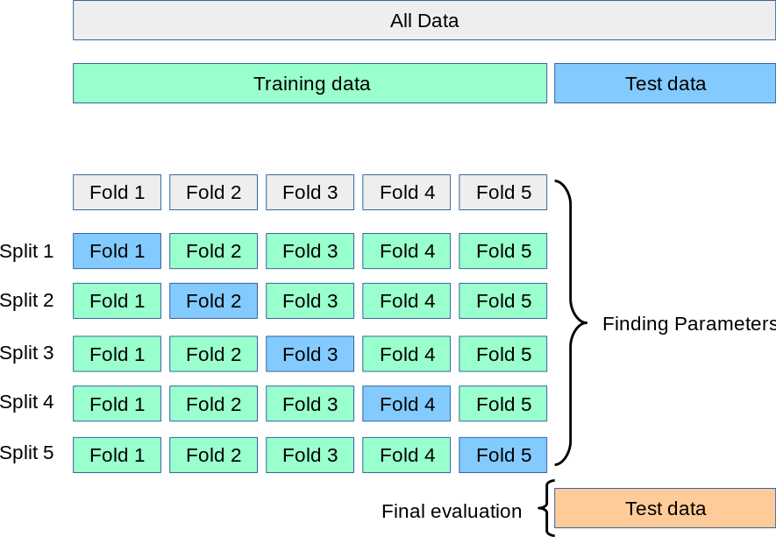
Dataset Preparation
Cross Validation
(8)

Slide 132
Dataset Preparation
In-Class Exercise
  Create a model with your choice of model and data. Using the cross_val_score method, adjust the number of folds, noting the following:
    How does the mean score change?
    How does the standard deviation change?
      Is this important?
    How does computational time change?

Slide 133
Dataset Preparation
Scaling Data
  Changing the values of the training data set in such a way to normalize, or convert the data into a specific range.
  Certain algorithms are more sensitive to data scaling:
    SVM
    K-nearest neighbors
    Logistic regression

Slide 134
Dataset Preparation
Scaling Data
  Scaling is more of an art form—there is no standard procedure that will increase accuracy for all models via scaling.

Slide 135
Dataset Preparation
Scaling Data
  Types of scalers
    Min Max Scaler (MinMaxScaler)
      Values scaled between 0 and 1
      Adversely affected by outlier values

Slide 136
Dataset Preparation
Scaling Data
  Types of scalers
    Standard Scaler (StandardScaler)
      Resulting distribution has a std dev = 1
      Resulting distribution has a variance = 1
      StandardScaler makes the mean ~ 0.
      Adversely affected by outlier values

Slide 137
Dataset Preparation
Scaling Data
  Types of scalers
    Robust Scaler (RobustScaler)
      Scales data to the interquartile range
        Interquartile range = Q3 – Q1
        Q3 is the value where 75% of the data occurs before the value, when the data is ordered.
        Q1 is the value where 25% of the data occurs before the value, when the data is ordered.
      Well suited for data sets with outliers

Slide 138
Dataset Preparation
Scaling Data
  Types of scalers
    For more scalers, and a visual comparison, see https://scikit-learn.org/stable/auto_examples/preprocessing/plot_all_scaling.html#sphx-glr-auto-examples-preprocessing-plot-all-scaling-py

Slide 139
Dataset Preparation
Scaling Data
  When scaling data, ensure both the training data and the test data are scaled.
    Test performance will plummet if it is not scaled as well.
  Ensure real-world data inputted into the model is also scaled.

Slide 140
Dataset Preparation
In-Class Exercise
  Using any chosen data set, scale model data of your choice using the 3 covered scalers:
    MinMaxScaler
    StandardScaler
    RobustScaler

Slide 141
Dataset Preparation
In-Class Exercise
  Apply each scaled set of data to a classifier and regressor data set.
    Suggest to try the scalers out on an SVM, or other sensitive classifier trainer.

Slide 142
Dataset Preparation
Converting Categories to Numbers
  Trainers understand numbers better than text. If there are a set number of text categories, converting them to numbers will help.
  If you have 5 categories, replacing them with numbers will make the model more accurate and/or more efficient.
    ‘Lake’ → 0
    ‘River’ → 1
    ‘Stream’ → 2
    ‘Ocean’ → 3
    ‘Pond’ → 4

Slide 143
Dataset Preparation
Converting Categories to Numbers
  Scikit-learn provides a transformer for this
    LabelEncoder
    Apply the encoder to each column of the data set that has categorical strings.
    Do this before splitting the data into training and testing data.

Slide 144
Dataset Preparation
Converting Categories to Numbers
  Go over in-class example using housing.csv data.

Slide 145
Dataset Preparation
In-Class Exercise
  Using the data at ‘./Session 7 - Python/Instructional Material/In-Class Exercises/Data/Inflation 1980-2020.csv’, load the data into Python and encode one of the category-based columns (such as the “LOCATION” column).

Slide 146
Dataset Preparation
Converting Categories to Numbers
  One issue with this is that some algorithms will assume numbers closer to each other will be more similar.

Slide 147
Dataset Preparation
Converting Categories to Numbers
  For example, look at the following data representing food:
    chicken → 0
    raspberries → 1
    salmon → 2
    turkey → 3
    yogurt → 4
  If we were trying to predict nutritional content of food, our model may assume chicken and raspberries are more related than chicken and turkey since the indices of chicken and raspberries are closer together.

Slide 148
Dataset Preparation
Converting Categories to Numbers
  One solution to this is to create a new feature for each numerical category, with a possible value of either 1 or 0.
    Instead of having one column that could have a value within the range [0,4], there would be 5 new columns each representing one of the values in the original column.
    Each new column will have a value of either 1 or 0
    This is called one-hot encoding.
      Scikit-Learn uses the OneHotEncoder transformer to handle this

Slide 149
Dataset Preparation
Converting Categories to Numbers
  Go over in-class example of one-hot encoding using housing.csv data.

Slide 150
Dataset Preparation
In-Class Exercise
  Using the data at ‘./Session 7 - Python/Instructional Material/In-Class Exercises/Data/Inflation 1980-2020.csv’, use the one-hot encoder to create multiple columns from one of the category-based columns (such as the “LOCATION” column).

Slide 151
Dataset Preparation
Converting Categories to Numbers
  To apply both binary encoder and one-hot encoder in one go, we can use the LabelBinarizer transformer.
  Note that for each of these methods, the output is an array of just the transformed column, not the entire data set including the new data.
    The transformed column data will need added back to the original data.

Slide 152
Dataset Preparation
Converting Categories to Numbers
  Go over in-class example of label binarizer encoding using housing.csv data.

Slide 153
Dataset Preparation
In-Class Exercise
  Using the data at ‘./Session 7 - Python/Instructional Material/In-Class Exercises/Data/Inflation 1980-2020.csv’, apply the LabelBinarizer and check the output against the sequential application of the LabelEncoding and OneHotEncoding methods in the previous exercise.
    This is more of a quick exercise to check for DataFrame and 2D array equality

Slide 154
Dataset Preparation
In-Class Exercise
  Train a model with both the string categories, and then with numerical categories.
    Does your trainer allow you to use string categorical data?
    How is accuracy affected by converting the string categories to numerical categories?
    How is the speed affected by converting the string categories to numerical categories?

Slide 155
Dataset Preparation
Estimating Missing Values
  Missing values can be interpreted as nan values (example on next slide).
  Missing values can throw off the accuracy of your model.
  Depending on the trainer, the data point may be ignored.

Slide 156
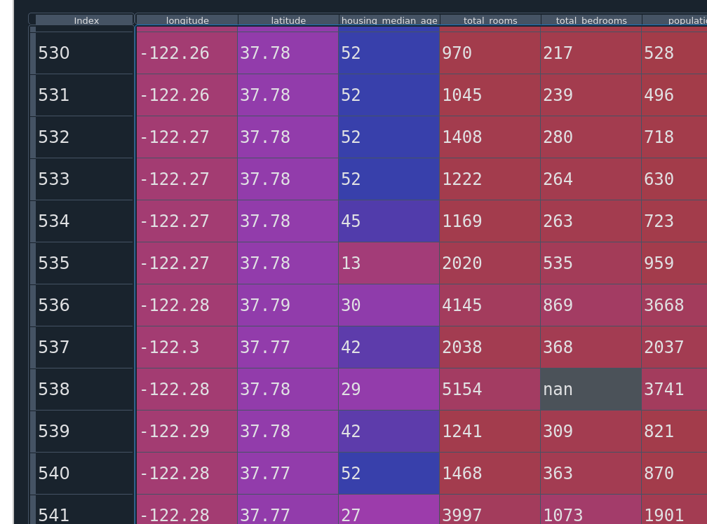
Dataset Preparation
Estimating Missing Values
Example of nan value in DataFrame shown within the data explorer of Spyder.

Slide 157
Dataset Preparation
Estimating Missing Values
  Scikit-learn utilizes the Imputer class to fill in missing data.
    In newer versions, use SimpleImputer.
  Can choose how you want missing values estimated.
    Known as the strategy.

Slide 158
Dataset Preparation
Estimating Missing Values
  Options for estimation (strategies):
    mean
    median
    most_frequent

Slide 159
Dataset Preparation
Estimating Missing Values
  Imputer only works on numerical values, not strings.
  If missing data in strings exist, they must be converted to numerical values or the columns must be removed.

Slide 160
Dataset Preparation
Estimating Missing Values
  Reminder/note: the import statement “from sklearn.preprocessing import Imputer” was deprecated with scikit-learn v0.20.4 and removed as of v0.22.2.
  Use “from sklearn.impute import SimpleImputer” instead

Slide 161
Dataset Preparation
Estimating Missing Values
  Go over Imputer example in class.

Slide 162
Dataset Preparation
In-Class Exercise
  For each column that has nan values, convert them to an estimated value using an imputer.
    Use any strategy you wish.
  Train a machine learning model with the imputed data.
    Remember how the model assumes correlations for numbers that are close together.

Slide 163
Dataset Preparation
Checking Feature Correlation
  We can check how closely correlated two features are with each other.
    One reason is to see how much changing one feature will affect another
      Such as a feature vs the collected target values.
    Another reason might be in deciding whether certain features can be removed from the data.
    Another reason might be in deciding how useful an engineered feature is.

Slide 164
Dataset Preparation
Checking Feature Correlation
  Use the .corr() method of a pandas DataFrame
    Creates a correlation matrix, showing correlations between each feature with all other features.
    Same as Pearson’s R correlation.
    Only for linear correlations.

Slide 165
Dataset Preparation
Checking Feature Correlation
  Use the .corr() method of a pandas DataFrame
    Ranges from [-1,1]
    Closer to 0 means the feature has less affect.
    Closer to 1 means increasing the feature increases the prediction, decreasing the feature decreases the prediction.
    Closer to -1 means increasing the feature decreases the prediction value, and vice versa.

Slide 166
Dataset Preparation
Checking Feature Correlation
  Go over Pandas DataFrame.corr() method in-class example.

Slide 167
Dataset Preparation
Checking Feature Correlation
  scipy Correlation Functions
    Pearson’s R Correlation
      Returns two values
        R value, as with the DataFrame.corr()
        Two-tailed p-value (see citation 11)
      For linear correlations
      Assumes normal distribution between features
      scipy.stats.pearsonr(iterable_1, iterable_2)
      Will not show non-linear correlations

Slide 168
Dataset Preparation
Checking Feature Correlation
  P-value
    “In statistics, the p-value is the probability of obtaining results at least as extreme as the observed results of a statistical hypothesis test, assuming that the null hypothesis is correct. The p-value serves as an alternative to rejection points to provide the smallest level of significance at which the null hypothesis would be rejected. A smaller p-value means that there is stronger evidence in favor of the alternative hypothesis. “ ^{[13]}

Slide 169
Dataset Preparation
Checking Feature Correlation
  P-value
    P-value compares the correlation factor of the data set used with that of an uncorrelated data set
    It is the probability that a random sample from the uncorrelated data set will have a correlation coefficient at least as great as that of the desired data set.

Slide 170
Dataset Preparation
Checking Feature Correlation
  P-value
    Another description is the p-value represents running an experiment that the data set chosen is not correlated.
    The smaller the p-value, the more correlated the data set is.

Slide 171
Dataset Preparation
Checking Feature Correlation
  scipy Correlation Functions
    Spearman’s Correlation
      Returns two values:
        Correlation value
        P-value “hypothesis test whose null hypotheisis is that two sets of data are uncorrelated.” (see citation 12)

Slide 172
Dataset Preparation
Checking Feature Correlation
  scipy Correlation Functions
    Spearman’s Correlation
      For non-linear correlations
      Does not assume features are normally distributed
      scipy.stats.spearmanr(iterable_1, iterable_2)
      Will also show linear correlations, but the magnitude will not be as high as with Pearson’s

Slide 173
Dataset Preparation
Checking Feature Correlation
  Remember that before splitting the data, the targets and training data are all in the same data structure.
  Can test the data correlation with the soon-to-be target column while everything is in the same structure.

Slide 174
Dataset Preparation
Checking Feature Correlation
  Go over SciPy correlation methods in-class example.

Slide 175
Dataset Preparation
In-Class Exercise
  Using data of your choice, show correlation factors using each method:
    DataFrame.corr()
    Pearson’s R (from SciPy)
    Spearman’s Correlation (from SciPy)

Slide 176
Dataset Preparation
Checking Feature Correlation
  Feature Importances
    With some machine learning models, we can check the feature_importances_ property.
    Decision trees have this property, as well as ensemble methods.
    Can call property once the model has been taught.

Slide 177
Dataset Preparation
Checking Feature Correlation
  Go over feature importance in-class example.

Slide 178
Dataset Preparation
In-Class Exercise
  Using the data from the previous exercise (or of your choice), train a model and show the feature importances.

Slide 179
Dataset Preparation
Dimensionality Reduction
  This concept reduces the number of dimensions in a data set
  Issues resolved
    Slow computation due to size
    Memory limitations
    Sometimes hard disk size limitations
    Curse of dimensionality

Slide 180
Dataset Preparation
Dimensionality Reduction
  Slow computation due to size
    The more features we have, the more computational power we need to train and run machine learning algorithms.
    Less dimensions means less CPU power needed

Slide 181
Dataset Preparation
Dimensionality Reduction
  Memory limitations
    More features means more memory is used to train and utilize machine learning algorithms.
    Very large datasets may not fit into memory.

Slide 182
Dataset Preparation
Dimensionality Reduction
  Hard Disk Space Limitations
    Just like with memory, we can sometimes run into hard disk space issues if too many features are utilized.
      This is much more unlikely than memory issues.

Slide 183
Dataset Preparation
Dimensionality Reduction
  Downside
    You are reducing a dimension, so there will be some data loss versus the original data set.

Slide 184
Dataset Preparation
Dimensionality Reduction
  Curse of Dimensionality
    The more dimensions you have, the more likely the dataset is to be sparse.
    The sparser the dataset, the further away each data point is from another one.

Slide 185
Dataset Preparation
Dimensionality Reduction
  Curse of Dimensionality
    Because of this, larger-featured datasets are at greater risk of being over-fitted due to ML algorithms needing to extrapolate more to fit the data.
      The algorithm doesn’t get enough data points close together to get a good idea of how to estimate data at a given point.

Slide 186
Dataset Preparation
Dimensionality Reduction
  Curse of Dimensionality
    For example, let’s say you want to estimate trees based on pictures.
    If you were to estimate only based on bark, how many pictures would you need?

Slide 187
Dataset Preparation
Dimensionality Reduction
  Curse of Dimensionality
    If you were to estimate based on bark, leaf shape, leaf color, leaf arrangement, and hardiness zones, how many pictures would you need?

Slide 188
Dataset Preparation
Dimensionality Reduction
  Curse of Dimensionality
    Very simplified counts below:
    Bark possibilities: 7
    Leaf shape possibilities: 6
    Leaf color possibilities: 4
    Leaf arrangement possibilities: 9
    Hardiness zone possibilities: 8

Slide 189
Dataset Preparation
Dimensionality Reduction
  Curse of Dimensionality
    With each new feature, we have more than one additional possible outcome.
      Exponential increase in data point possibilities.
      Exponential increase in required data points to fully constrain data.
    And this is just as it applies to a classification problem.

Slide 190
Dataset Preparation
Dimensionality Reduction
  Two types:
    Projection
    Manifold

Slide 191
Dataset Preparation
Dimensionality Reduction
  Projection
    Finding the points of a data set on a lower dimensional hyperplane.
      Taking the “shadow” of the points on a lower dimension hyperplane.
    Effective when the points of an N dimensional data set lie close to an N-1 dimensional hyperplane.

Slide 192
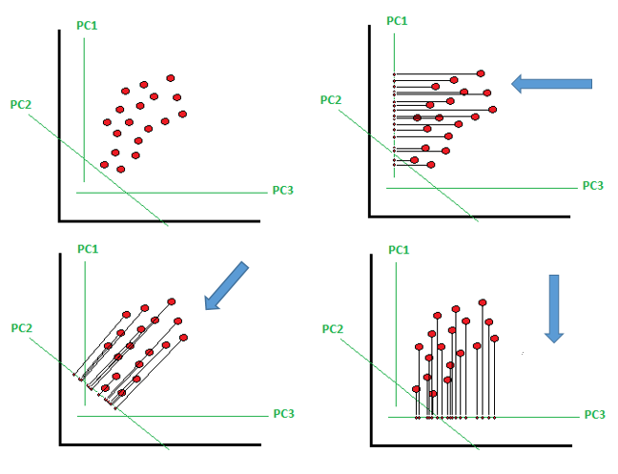
Dataset Preparation
Dimensionality Reduction
  Projection
[17]

Slide 193
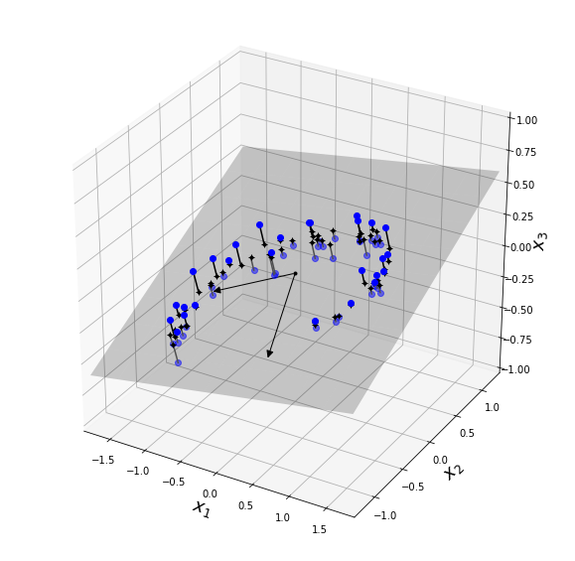
Dataset Preparation
Dimensionality Reduction
  Projection
[16]

Slide 194
Dataset Preparation
Dimensionality Reduction
  Projection
    In theory, there are an unlimited number of lower-dimensional hyperplanes we can project on to.
    In general, we want to pick the lower-dimensional hyperplane such that variance is maximized.

Slide 195
Dataset Preparation
Dimensionality Reduction
  Projection
    The larger the variance, the less information we will lose (with respect to the original data set).
    The larger the variance, the more variety of data we keep for the ML algorithm to learn from.

Slide 196
Dataset Preparation
Dimensionality Reduction
  Projection Algorithms
    Principal Component Analysis (PCA)
      Reduces the data set down to δ dimensions.
      Finds δ axes of the largest variance, ordered descending.
        These are known as the principal components.
        Each principal component is orthogonal (90°) to the others.

Slide 197
Dataset Preparation
Dimensionality Reduction
  Projection Algorithms
    Principal Component Analysis (PCA)
      Transforms the data set by projecting each data point onto these δ dimensions.
      Principal components are not guaranteed to be the same in subsequent executions of the algorithm.

Slide 198
Dataset Preparation
Dimensionality Reduction
  Projection Algorithms
    Principal Component Analysis (PCA)
      As a starting guideline, choose the number of δ principal components to maintain 95% of the variance.
      Note that scaling is important before applying PCA if the features span multiple orders of magnitude.

Slide 199
Dataset Preparation
Dimensionality Reduction
  Projection Algorithms
    Principal Component Analysis (PCA)
      Also note that this just transforms the data in preparation for a ML algorithm.

Slide 200
Dataset Preparation
Dimensionality Reduction
  Projection Algorithms
    Go over in-class example of principal component analysis.

Slide 201
Dataset Preparation
In-Class Exercise
  Using the data from the previous exercise (or of your choice), train a model using PCA-transformed data.
    Create the PCA object
    Transform and fit the data
    Feed to ML algorithm
    Check accuracy

Slide 202
Dataset Preparation
Dimensionality Reduction
  Projection Algorithms
    Incremental Principal Component Analysis
      Splits the dataset into smaller batches, feeding the algorithm one batch at a time.

Slide 203
Dataset Preparation
Dimensionality Reduction
  Projection Algorithms
    Incremental Principal Component Analysis
      Will reduce the computational cost of performing PCA.
      If data is too large for operations after PCA, will need to run machine learning models that also incorporate partial fit for each batch.

Slide 204
Dataset Preparation
Dimensionality Reduction
  Projection Algorithms
    Incremental Principal Component Analysis
      Useful when we can’t fit the entire dataset in memory.
      Useful if we are training online.
        Using in a system constantly receiving new data

Slide 205
Dataset Preparation
Dimensionality Reduction
  Projection Algorithms
    Incremental Principal Component Analysis
      Uses partial_fit() vs fit()

Slide 206
Dataset Preparation
Dimensionality Reduction
  Projection Algorithms
    Go over in-class example of incremental principal component analysis.

Slide 207
Dataset Preparation
In-Class Exercise
  Using data of your choice, train a model using data transformed from incremental PCA.
    Create the IncrementalPCA object
    Transform and fit the data
    Feed to ML algorithm
    Check accuracy

Slide 208
Dataset Preparation
Dimensionality Reduction
  Projection Algorithms
    Randomized Principal Component Analysis
      Quick approximation that is much faster than PCA when the number of principal components (δ) is much smaller than the features in the original dataset (n).

Slide 209
Dataset Preparation
Dimensionality Reduction
  Projection Algorithms
    Go over in-class example of randomized principal component analysis.

Slide 210
Dataset Preparation
In-Class Exercise
  Using data of your choice, train a model using data transformed from randomized PCA.
    Create the PCA object
    Transform and fit the data
    Feed to ML algorithm
    Compare accuracy between the randomized PCA and normal PCA
    Optionally, compare execution time

Slide 211
Dataset Preparation
Dimensionality Reduction
  Projection Algorithms
    Kernel Principal Component Analysis
      Similar to kernel trick in the support vector machines.
      Review kernel trick and gamma hyperparameter in SVM section (slide 83).

Slide 212
Dataset Preparation
Dimensionality Reduction
  Projection Algorithms
    Kernel Principal Component Analysis
      Add feature(s) to get into a higher dimension space, then use kernel trick to get projection back on to lower dimensional space.

Slide 213
Dataset Preparation
Dimensionality Reduction
  Projection Algorithms
    Kernel Principal Component Analysis
      Mathematically, we can calculate the components of PCA by performing vector dot products in a higher space.
      The dot product of vectors is the same as a projection onto a lower dimensional space.

Slide 214
Dataset Preparation
Dimensionality Reduction
  Projection Algorithms
    Kernel Principal Component Analysis
      Pros
        Computationally cheaper than calculating the components using normal PCA.
        Good at preserving clusters of data.
        Can sometimes unroll data in a manifold.

Slide 215
Dataset Preparation
Dimensionality Reduction
  Projection Algorithms
    Kernel Principal Component Analysis
      Cons
        Error is introduced into the data.

Slide 216
Dataset Preparation
Dimensionality Reduction
  Projection Algorithms
    Kernel Principal Component Analysis
      Cons
        With normal PCA, we can perfectly transform the PCA data set back to the original data set if we maintain the same number of components.
        This is not true with kernel PCA.

Slide 217
Dataset Preparation
Dimensionality Reduction
  Projection Algorithms
    Kernel Principal Component Analysis
      Use a kernel functions to perform the dot product operation.
      Kernel function gives the dot product of the vectors into a higher dimensional feature space ^{[18]}.
      Not every function is a kernel function.

Slide 218
Dataset Preparation
Dimensionality Reduction
  Projection Algorithms
    Kernel Principal Component Analysis
      Go over in-class example.

Slide 219
Dataset Preparation
In-Class Exercise
  Using data of your choice, train a model using data transformed from kernel PCA.
    Create the PCA object
    Transform and fit the data
    Feed to ML algorithm
    Try different kernels
      rbf
      sigmoid
      Poly (don’t forget the “degree” argument when using this one)

Slide 220
Dataset Preparation
Dimensionality Reduction
  Manifold
    An (N-1)-dimensional object that is contorted in an N-dimensional space.
    A 2-D manifold would be a 2-dimensional shape in an N-dimensional space.

Slide 221
Dataset Preparation
Dimensionality Reduction
  Manifold
    Manifold assumption – most real-world, high-dimension data sets lie close to a much lower-dimensional manifold.
      Needs to be empirically confirmed.

Slide 222
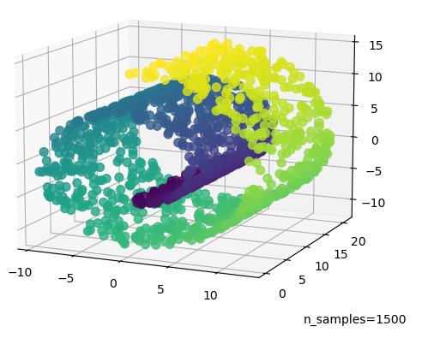
Dataset Preparation
Dimensionality Reduction
  Manifold
[14]

Slide 223
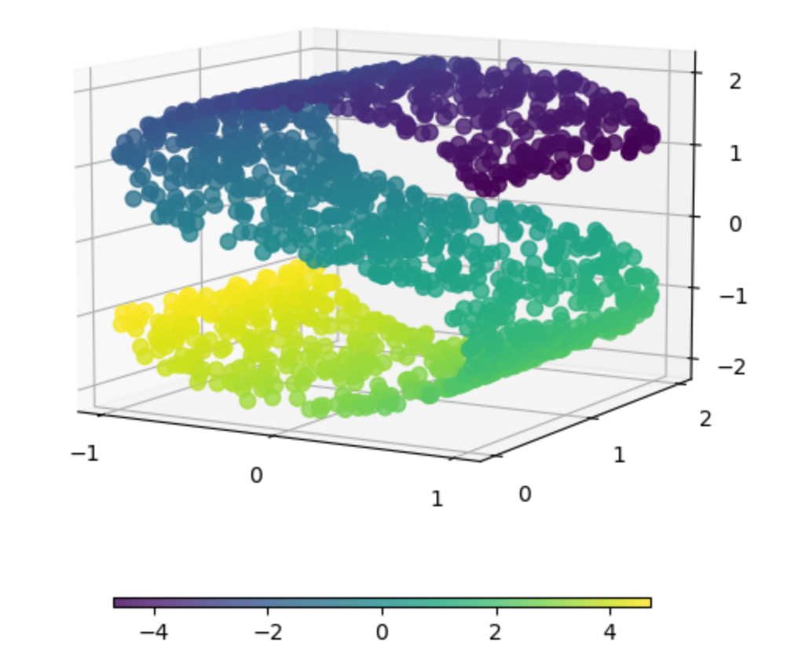
Dataset Preparation
Dimensionality Reduction
  Manifold
[15]

Slide 224
Dataset Preparation
Dimensionality Reduction
  Manifold Algorithms
    Locally Linear Embedding (LLE)
      Use k closest neighbors to reconstruct a linear version of the current data sample, x.
        Determine weights that minimizes square distance between data sample x, and the linearized variant of x (called xL)

Slide 225
Dataset Preparation
Dimensionality Reduction
  Manifold Algorithms
    Locally Linear Embedding (LLE)
      Minimize the following:
      xi is the current data sample out of m total samples
      xj is one of the other data points
      wi,j is the weight for the jth data point while trying to estimate the ith point (0 if not one of the closest neighbors.

Slide 226
Dataset Preparation
Dimensionality Reduction
  Manifold Algorithms
    Locally Linear Embedding (LLE)
      Then, the training instances x are mapped onto a lower-dimensional space, attempting to preserve the relationships between all x’s and their k closest neighbors as much as possible.

Slide 227
Dataset Preparation
Dimensionality Reduction
  Manifold Algorithms
    Locally Linear Embedding (LLE)
      While keeping the pre-determined weights fixed, find the optimal positions of x in the new space.

Slide 228
Dataset Preparation
Dimensionality Reduction
  Manifold Algorithms
    Locally Linear Embedding (LLE)
      Z is the matrix of all mapped points
      zi is the new ith data point
      zj is the new neighbor
      wi,j are the weights calculated from the original space

Slide 229
Dataset Preparation
Dimensionality Reduction
  Manifold Algorithms
    Go over in-class example.

Slide 230
Dataset Preparation
In-Class Exercise
  Apply LLE on a dataset of your choice, then send the data to a machine learning trainer of your choice..
    How does the end result compare with a ML trainer without using LLE?
    If LLE did not help the score, why did it not?

Slide 231
Dataset Preparation
Manually Engineering Features
  Create new features based on existing features.
  Look for meaningful relationships in the data, such as ratios.
  Use correlation coefficients to determine if the new features are useful or not.

Slide 232
Dataset Preparation
Manually Engineering Features
  Examples:
    In housing data, maybe the number of bedrooms/number of total rooms will be a better feature.
    In stock data, maybe the stock price/company earnings ratio is more meaningful than the price of the stock alone when determining if a stock is a bargain to buy or not.

Slide 233
Dataset Preparation
Manually Engineering Features
  Examples:
    Maybe comparing a value to the max, min, median, average, etc of all values will give a more useful feature.

Slide 234
Dataset Preparation
Section Summary
  Scaling Data
    Standard
    Robust
    Min-Max
  Correlation Coefficients
    Pearson’s R Value
    Spearman’s R Value

Slide 235
Dataset Preparation
Section Summary
  Converting String Categories
    Converting strings to numbers
      Label Encoding
    Creating a separate column for each number
      One Hot Encoding
      Label Binarizer for an all-in-one approach

Slide 236
Dataset Preparation
Section Summary
  Dimensionality Reduction
    Principal Component Analysis
      Projection data
      Types
        Normal
        Incremental
        Random
        Kernel

Slide 237
Dataset Preparation
Section Summary
  Dimensionality Reduction
    Locally Linear Embedding
      Useful for data close to a manifold

Slide 238
Dataset Preparation
Section Summary
  Manual Feature Engineering
    Look for meaningful relationships/factors in the data to create new features from

Slide 239
Dataset Preparation
In-Class Exercise
  Apply each of the following steps, checking the accuracy after each step is applied:
    Cross validation instead of train test split
    Scale the data
    Convert any string categories to numbers
    Remove weak features using correlation coefficients
    Apply any technique from Principle Component Analysis, or LLE, to find most impacting features.
    How does the end result with PCA/LLE compare to the initial accuracy without it?

Slide 240
Dataset Collection

Slide 241
Dataset Collection
Overview
  Pulling Data from Scikit-Learn Datasets
  Pulling Data from CSV
  Pulling Data from Excel
  Pulling Data from SQL Databases
  Pulling Data from Website

Slide 242
Dataset Collection
Pulling Data from Scikit-Learn Datasets
  Sckit-Learn comes with many datasets that are gathered from calling a function
  Under sklearn.datasets
  Creates dictionaries that include data, descriptions, feature names, targets, target names, etc
  Eg: from sklearn.datasets import load_iris

Slide 243
Dataset Collection
Pulling Data from Scikit-Learn Datasets
  3 types:
    Fetch
      Pulls data from internet
      Ex: from sklearn.datasets import fetch_california_housing
    Load
      Pulls data from local library
      Ex: from sklearn.datasets import load_iris
    Make
      Generates data from input
      Ex: from sklearn.datasets import make_swiss_roll

Slide 244
Dataset Collection
Class Example
  Load iris data and show keys

Slide 245
Dataset Preparation
In-Class Exercise
  Load each type of data, and plot the data for visualization (where applicable):
    Fetch
    Load
    Make

Slide 246
Dataset Collection
Pulling Data from CSV
  Can import CSV data directly into a Pandas dataframe
    pd.read_csv
  Can also load data opening a CSV as a text file, and manually storing data in a structure.
    With open() syntax

Slide 247
Dataset Collection
Pulling Data from CSV
  Can also use csvreader class
    Allows specification of:
      Element delimiters
      Quote characters
      Autoremoval of newline characters

Slide 248
Dataset Collection
Pulling Data from CSV
  A note about CSV data in general
    Not a well-utilized standard.
    The styles can vary widely
    Some styles use double-quotes around every element
    Some styles only put double-quotes around elements that contain spaces
    Be sure to double-check your data once it is pulled to ensure all elements have been separated out.

Slide 249
Dataset Collection
Class Example
  Loading data in a CSV format
    Using pandas
    Opening file like a text file
    Using csvreader

Slide 250
Dataset Collection
In-Class Exercise
  Using CSV data of your choice, load data into a pandas DataFrame and/or container datatype of your choice using the 3 methods discussed:
    Pandas read_csv()
    Reading the CSV file as a text file
    Using csvreader()

Slide 251
Dataset Collection
Pulling Data from Excel
  Can use pandas read_excel function.
  Newer openpyxl engine can read .xlsx files.
  Xlrd engine reads older .xls files.
  Pandas will automatically determine the correct engine to use.
  Sometimes can get an issue with the encoding of the file that needs adjusted.

Slide 252
Dataset Collection
Class Example
  Loading data in Excel format into a pandas DataFrame.
  Changing encoding of file

Slide 253
Dataset Collection
Pulling Data from OpenData Sheets
  Can use pandas read_excel function.
  If the function doesn’t understand the file, can import the odfpy library, and use the ‘ODF’ engine when reading the file.

Slide 254
Dataset Collection
Class Example
  Loading open datasheet format files

Slide 255
Dataset Collection
In-Class Exercise
  Using sheet data of your choice (either ods or Excel), load data into a pandas DataFrame.

Slide 256
Dataset Collection
Pulling Data from SQL Databases
  Can use Pandas read_sql()
  Will need a connection string to tell Python what to connect to, and how to connect to it.
  Will need a valid query string to tell database what data is needed.

Slide 257
Dataset Collection
Class Example
  Loading SQLite database.

Slide 258
Dataset Collection
In-Class Exercise
  Using a database of your choice, pull data from the following database objects:
    Table
    View
    Custom query
  See class example file for location of SQLite database if you’d like to use that.

Slide 259
Dataset Collection
Pulling Data from Website
  Urllib
  BeautifulSoup
  Parsing XML
  Parsing JSON

Slide 260
Dataset Collection
urllib
  Used to connect to websites via HTTP
  Works similar to reading files with open()
  Create a webfile handle with urllib.request.urlopen(<html_url>)
    <html_url> is the webpage you wish to read.
    Must be an HTTP site

Slide 261
Dataset Collection
BeautifulSoup
  Used to parse and analyze HTML structure.
  Part of the bs4 library
  Creates an object that has HTML tags as properties.
    soup.head
    soup.body
    soup.p
    etc

Slide 262
Dataset Collection
BeautifulSoup
  Helper functions can be used to retrieve specific data
    Certain attributes
    Certain number of specific elements/text
    Tags with certain id’s

Slide 263
Dataset Collection
BeautifulSoup
  <soup_property>.find_all(<element_string>)
    Finds all children elements specified.
    Recursive.
    Returns a list of all finds.
      soup.head.find_all('meta') returns all <meta> elements.
      soup.body.find_all(‘a’) finds all <a> reference elements in the body.

Slide 264
Dataset Collection
BeautifulSoup
  <soup_property>.find_all(<element_string>)
    Can use a list to find more than one element.
      soup.body.find_all(['p','a']) gets all <p> and <a> elements in the <body>

Slide 265
Dataset Collection
BeautifulSoup
  <soup_property>.get()
    Gets a specific attribute of a specified BeautifulSoup property.
    If more than one matches occur, only the first is returned.
      soup.body.p.get('style') returns each style from each <p> tag in the body.
      soup.body.a.get('href') will return the values of each href from each <a> within the body of the webpage.

Slide 266
Dataset Collection
BeautifulSoup
  Go over in-class examples.

Slide 267
Dataset Collection
In-Class Exercise
  Find all references from a webpage.
  Get only the links to JavaScript libraries from a webpage.
    Example webpage: https://blog.perkinelmer.com/posts/gas-chromatography-explained-what-it-is-and-how-it-works/
  From your favorite python package, get the package name and URL from pypi
    For instance, Sphinx can be found at https://pypi.org/simple/sphinx/
  Get the URL’s for all the US mirrors for GCC compilers from
    Mirrors can be found at https://gcc.gnu.org/mirrors.html
    Only need to look in the /releases/ folder

Slide 268
Dataset Collection
Parsing XML
  eXtensible Markup Language
  Uses tags to denote information and structure
  XML elements are XML’s version of statements
  Programmer-defined tags identify top of information, similar to a variable name
    Angle bracket denoted
    Children elements are declared between the open and closing tags.
      <book>
        <title>The Count of Monte Cristo</title>
        <author>Alexandre Dumas</author>
      </book>

Slide 269
Dataset Collection
XML Namespaces
  Xmlns defines what each tag means
  Namespaces allow for multiple specifications and can separate out same-name tags that mean different things.

Slide 270

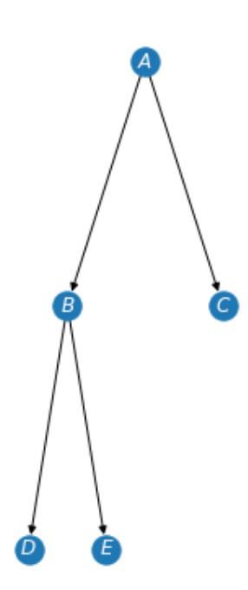
Dataset Collection
XML Namespaces
  <trees xmlns:arborist=”http://this.is.a.fake.site.for.arborists.com”
      xmlns:data_struct=”http://this.is.a.fake.site.for.data.structs.com”>
    <arborist:tree>
      <arborist:type>Red Maple</arborist:type>
      <arborist:leaf_color>red</arborist:leaf_color>
      <arborist:bark>rough</arborist:bark>
    </arborist:tree>
    <data_struct:tree>
      <data_struct:node>A</data_struct:node>
      <data_struct:node>B</data_struct:node>
      <data_struct:node>C</data_struct:node>
      <data_struct:node>D</data_struct:node>
      <data_struct:node>E</data_struct:node>
      <data_struct:edge>A->B</data_struct:edge>
      <data_struct:edge>A->C</data_struct:edge>
      <data_struct:edge>B->D</data_struct:edge>
      <data_struct:edge>B->E</data_struct:edge>
    </data_struct:tree>
  </trees>

Slide 271
Dataset Collection
XML Attributes
  Attributes are an additional place data can be stored.
  Stored in the tag of an element vs a child node.
  Example underlined below:
  <arborist:tree mi_population=”154000”>
    <arborist:type>Red Maple</arborist:type>
    <arborist:leaf_color>red</arborist:leaf_color>
    <arborist:bark>rough</arborist:bark>
  </arborist:tree>

Slide 272
Dataset Collection
XML Attributes
  No rules on which data should be an attribute and which data should be a child element.
  Can gather using the xml module

Slide 273
Dataset Collection
XML
  Go over in-class examples.

Slide 274
Dataset Collection
In-Class Exercise
  Get all the plant names from the W3 schools example XML file at https://www.w3schools.com/xml/plant_catalog.xml
  Using the same plant XML file, sort the data by hardiness zone. Select an appropriate data structure in Python to hold the data.
  Get the XML string from https://learn.microsoft.com/en-us/previous-versions/windows/desktop/ms762271(v=vs.85), and convert the data into a CSV or spreadsheet file.
    Hint: Look for the <code> tag
  Using the class example namespace xml file, get the text of all edges
    File located at ./PracticalProgramming/Session 7 - Python/Instructional Material/In-Class Exercises/namespace_example.xml.

Slide 275
Dataset Collection
Parsing JSON
  JavaScript Object Notation
  Stores data structure in a string format.
    Objects are stored in curly braces
      Interpreted as dictionaries to Python
    Arrays are stored in square brackets
      Interpreted as lists in Python
    Other primitive data types are stored as you would expect

Slide 276
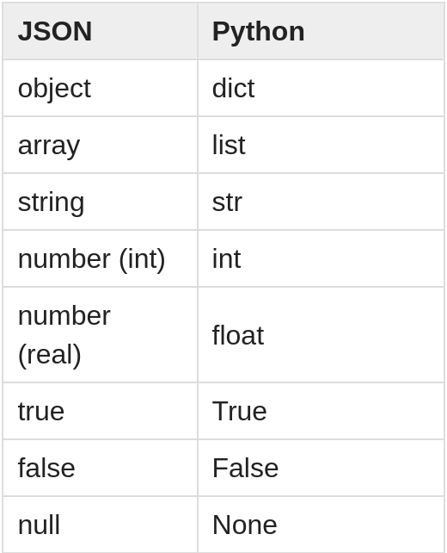
Dataset Collection
Parsing JSON
  JavaScript Object Notation
  Stores data structure in a string format.
    Other types:
[20]

Slide 277
Dataset Collection
Parsing JSON
  Standard can be found at https://www.ecma-international.org/publications-and-standards/standards/ecma-404/

Slide 278
Dataset Collection
Parsing JSON
  Simple example:
    {"widget": {
    "debug": "on",
    "window": {
    "title": "Sample Konfabulator Widget",
    "name": "main_window",
    "width": 500,
    "height": 500
    },
    "image": {
    "src": "Images/Sun.png",
    "name": "sun1",
    "hOffset": 250,
    "vOffset": 250,
    "alignment": "center"
    },
    "text": {
    "data": "Click Here",
    "size": 36,
    "style": "bold",
    "name": "text1",
    "hOffset": 250,
    "vOffset": 100,
    "alignment": "center",
    "onMouseUp": "sun1.opacity = (sun1.opacity / 100) * 90;"
    }
    }}

Slide 279
Dataset Collection
Parsing JSON
  Can use the json library to convert to and from JSON using objects.
    JSONDecoder class converts JSON string to Python data types based on the table shown in a previous slide
    JSONEncoder class converts Python structures/types to a JSON string.

Slide 280
Dataset Collection
Parsing JSON
  Go over in-class JSON examples.

Slide 281
Dataset Collection
In-Class Exercise
  Get the size of the fruit from the data at https://support.oneskyapp.com/hc/en-us/article_attachments/202761627/example_1.json
    This is the first URL example in the in-class code
  Create a key-value pair for the questions to answers from the data at https://support.oneskyapp.com/hc/en-us/article_attachments/202761727/example_2.json
    This is the URL from the 2nd JSON web example in the in-class code.
  Get the names of all the servlets from the web-app at https://json.org/example.html
    This one will require HTML parsing, as well as JSON.
    Try to use the JSON library to get the servlet names, not just BeautifulSoup
  Extra credit: convert the JSON data to XML data from the website http://ergast.com/api/f1/2004/1/results.json

Slide 282
Evaluating Accuracy of Classifiers

Slide 283
Evaluating Accuracy of Classifiers
Overview
  Precision Recall Curves
    precision_recall_curve()
  Receiver Operating Characteristics (ROC) Curve
    roc_curve()
  Area Under the Curve (AUC)
    roc_auc_score()
  Mean Squared Error
    mse

Slide 284
Evaluating Accuracy of Classifiers
Why accuracy alone isn’t enough
  Skewed datasets
    If the dataset contains many more targets of one classification vs another, it is very easy to get high accuracy by just guessing the most likely class.

Slide 285
Evaluating Accuracy of Classifiers
Why accuracy alone isn’t enough
  High importance of not getting false positives or false negatives
    Predicting a false negative for something like cancer recognition is much less preferred than predicting a false positive.
      i.e. we would rather have the model incorrectly predict a benign tumor is malignant vs predict a malignant tumor benign.

Slide 286
Evaluating Accuracy of Classifiers
Except for mean squared error, all of these methods only apply to classification trainers and models.

Slide 287
Evaluating Accuracy of Classifiers
Abbreviations for Upcoming Slides
  TP = True Positive count
  FP = False Positive count
  TN = True Negative count
  FN = False Negative count

Slide 288
Evaluating Accuracy of Classifiers
Precision
  TP/(TP+FP)
    Represents number of correct classifications of the positive class over all predictions of the positive class
  Can achieve 100% if a single prediction is made and it is correct.
    Must look at other metrics.

Slide 289
Evaluating Accuracy of Classifiers
Recall
  TP/(TP+FN)
    Represents correct predictions of the positive compared to the true number of positive class data points.
  A.k.a. True Positive Rate
  A.k.a. Sensitivity

Slide 290
Evaluating Accuracy of Classifiers
F1 Score
  Harmonic mean of precision and recall.

Slide 291
Evaluating Accuracy of Classifiers
Increasing precision decreases recall, and vice versa.
  Recall = TP/(TP+FN) = TP/All Actual Positives
  Precision = TP/(TP+FP) = TP/All Predicted Positives
  Total number of predictions
    TP + FP + TN + FN

Slide 292
Evaluating Accuracy of Classifiers
Increasing precision decreases recall, and vice versa.
  Which parameter you wish to maximize depends on your application.
  Do you want a balanced classifier? Maximize the F1 score.

Slide 293
Evaluating Accuracy of Classifiers
Increasing precision decreases recall, and vice versa.
  Do we want to minimize false positives? If so, maximize precision.
    We may miss some true positives, but the false positives can be eliminated.
    Think of estimating good tenants. Some tenants who are good will get discarded, but all the tenants chosen will be good tenants.

Slide 294
Evaluating Accuracy of Classifiers
Increasing precision decreases recall, and vice versa.
  Do we want to minimize false negatives? Then maximize recall.
    We can get all the positives, but will also get some false positives in the mix.
    Good for our breast cancer predictions.

Slide 295
Evaluating Accuracy of Classifiers
More Metrics
  False Positive Rate
    FP/(TP+FN) = 1-TNR
  True Negative Rate (Specificity)
    TN/(TN+FP) = 1-FNR
  Accuracy
    (TP + TN)/(TP + TN + FP + FN)

Slide 296
Evaluating Accuracy of Classifiers
Confusion Matrix
  2-dimensional data table
  Measure of how “confused” our model is.
  Each cell shows how many classifications were predicted, and what the actual target was.
  Rows are actual targets
  Columns are predicted targets

Slide 297
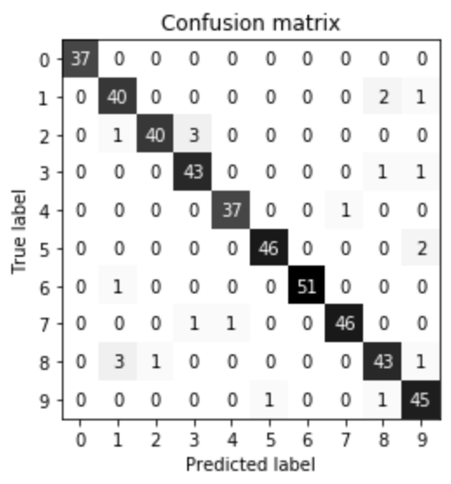
Evaluating Accuracy of Classifiers
Confusion Matrix
  Example

Slide 298
Evaluating Accuracy of Classifiers
Precision Recall Curves
  Plot of precision on the dependent axis, and recall on the independent axis.
  Remember there is a trade-off between precision and recall – we cannot have perfect values for both.

Slide 299
Evaluating Accuracy of Classifiers
Precision Recall Curves
  Plot of precision on the dependent axis, and recall on the independent axis.

Slide 300
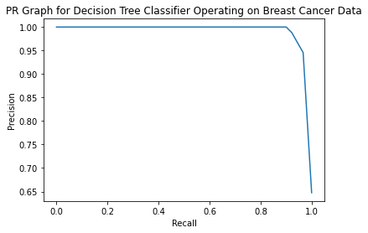
Evaluating Accuracy of Classifiers
Precision Recall Curves

Slide 301
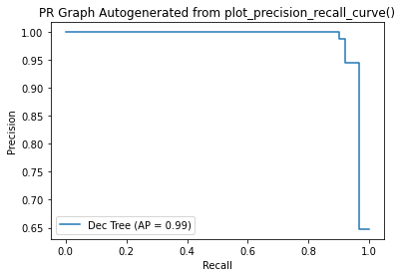
Evaluating Accuracy of Classifiers
Precision Recall Curves

Slide 302
Evaluating Accuracy of Classifiers
Receiver Operating Characteristics (ROC) Curve
  Plots True Positive Rate vs False Positive Rate.
  Pots further to the upper left corner are more accurate at making predictions.

Slide 303
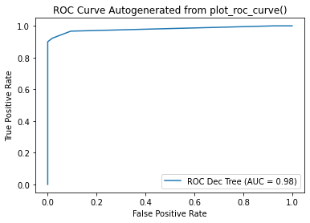
Evaluating Accuracy of Classifiers
Receiver Operating Characteristics (ROC) Curve

Slide 304
Evaluating Accuracy of Classifiers
Area Under the Curve (AUC)
  This is the area under the ROC curve.
  Gives a single value measure of the ROC performance of a classifier.
  Values of 1 represent a perfect classifier.
  Values of 0.5 represent a purely random classifier.

Slide 305
Evaluating Accuracy of Classifiers
Multiclass Classifier Evaluation
  Most methods up to this point have been for binary classification applications.
  Can compare each class prediction vs another in each classifier to estimate performance.

Slide 306
Evaluating Accuracy of Classifiers
Multiclass Classifier Evaluation
  For instance, can create multiple models predicting whether each data point is a true or false for each classification.
    First model predicts whether the iris is a virginica
    Second model predicts whether the iris is a versicolor
    Etc.

Slide 307
Evaluating Accuracy of Classifiers
Summary
  Each of these metrics is a measure of prediction abilities for a given classifier.
  A higher score from one metric does not always mean the classifier is better. Each application has unique needs, and trade-offs need to be evaluated.

Slide 308
Evaluating Accuracy of Classifiers
Go over in-class examples

Slide 309
Evaluating Accuracy of Classifiers
In-Class Exercise
  With the data of your choice, build a classifier and show the following:
    Display the PR curve
    Display the ROC curve
    Calculate the AUC for the ROC curve
    Generate a confusion matrix.
  With data of your choice, build two classifiers and pick the better classifier based on performance metrics. What metrics are important to the data set you have chosen?

Slide 310
Evaluating Accuracy of Regressors

Slide 311
Evaluating Accuracy of Regressors
Overview
  Mean Squared Error
  Coefficient of Determination (R²)
  Residuals Plot
  Prediction Error Plot

Slide 312
Evaluating Accuracy of Regressors
Mean Squared Error
  This represents a type of weighted average of the differences between predicted values and actual values.
  This is a measure of how far off the predicted values are from the actual values.
  The lower the value, the better.

Slide 313
Evaluating Accuracy of Regressors
Mean Squared Error
    M is the number of samples
    Y_{predict} = w₁*f₁ + w₂*f₂ + w₃*f₃ + … + w_{n}*f_{n} + b + r
      Y_{predict} = predicted value for a given sample
      w = weights
      f = feature value
      n = number of features
      b = intercept of linear line
      r = regularization parameter

Slide 314
Evaluating Accuracy of Regressors
Coefficient of Determination (R²)
  Measure of the percentage of variation in the output the input variable can account for.
  A score of 1 means that the inputs can predict 100% of the output.
  This is a measure of goodness of fit of our model.

Slide 315
Evaluating Accuracy of Regressors
Coefficient of Determination (R²)
  Usually, you want this value to be in the 0.90 range or above.

Slide 316
Evaluating Accuracy of Regressors
Residuals Plot
  Residual is the difference between the predicted value and the actual value.
  This plot is just the residuals vs the actual values.

Slide 317
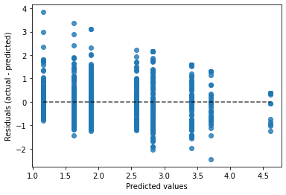
Evaluating Accuracy of Regressors
Residuals Plot

Slide 318
Evaluating Accuracy of Regressors
Prediction Error Plot
  This is just a simple plot of the predicted targets vs the actual targets.

Slide 319
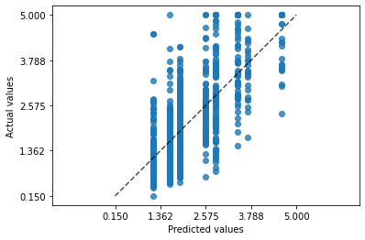
Evaluating Accuracy of Regressors
Prediction Error Plot

Slide 320
Evaluating Accuracy of Regressors
Go over in-class example code

Slide 321
Evaluating Accuracy of Regressors
In-Class Exercise
  With the data of your choice, build a regressor and show the following:
    Calculate the mean squared error
    Calculate the coefficient of determination
    Display the residuals vs actual values in a plot
    Display the predicted values vs actual values in a plot

Slide 322
Ensemble Methods

Slide 323
Ensemble Methods
Overview
  Background
  Voting Classifiers
  Bagging and Pasting
  Random Forests
  Boosting
  Stacking

Slide 324
Ensemble Methods
Background
  By using drastically different trainers for each data set, we can often get a better prediction than the best trainer created for any individual trainer.
  The models can be of the same type of trainer, or different types.

Slide 325
Ensemble Methods
Background
  For instance, a group of decision trees can be used, or a decision tree, logistic regression, and k-nearest neighbor models.
  A group of models used in conjunction with each other is called an ensemble.

Slide 326
Ensemble Methods
Background
  The more independent each model is from the others, the more accurate the ensemble will be.
    This averages out the errors produced by each model.
  The more models you have, the more accurate the ensemble will be as long as the models are sufficiently independent.

Slide 327
Ensemble Methods
Voting Classifiers
  Train multiple different classifiers.
  Using the VotingClassifier, have each classifier vote on what the predicted label should be.

Slide 328
Ensemble Methods
Voting Classifiers
  Hard vs Soft Voting
    Hard is a simple vote
    Soft voting calculates the class probabilities from each model, averages them over all individual models, and chooses the class with the highest probability as the predicted class.

Slide 329
Ensemble Methods
Voting Classifiers
  Hard vs Soft Voting
    Soft voting requires that the trainer can estimate probabilities.
      Some trainers do not have this method by default, but can be passed a keyword to tell the trainer to calculate them.
        Support Vector Classifiers are an example.
    Soft voting can be more accurate, since they take in to account confidence of the predictions.

Slide 330
Ensemble Methods
Voting Classifiers
  Go over example code.

Slide 331
Ensemble Methods
In-Class Exercise
  Create a voting ensemble with multiple different classifiers.
  Compare the accuracy score of the individual models with that of the ensemble.
  Utilize both hard and soft voting.

Slide 332
Ensemble Methods
Bagging and Pasting
  In both of these methods, multiple instances of the same type of trainer is used.

Slide 333
Ensemble Methods
Bagging and Pasting
  In bagging, a random set of the data is chosen for each trainer.
    The same data point can be used multiple times in the same instances.
    This is referred to as “with replacement”

Slide 334
Ensemble Methods
Bagging and Pasting
  In pasting, no two data points can exist in the same instance, but can exist in multiple instances.
    This is referred to as “without replacement”.

Slide 335
Ensemble Methods
Bagging and Pasting
  Determining predicted outcome.
    Hard voting is used for classifiers
    Soft voting is used for regressors

Slide 336
Ensemble Methods
Bagging and Pasting
  Because multiple trainers are being used, each trainer can be built on a separate CPU core, if applicable.

Slide 337
Ensemble Methods
Bagging and Pasting
  Since we are pulling data at random, some of the data points will not be used in training.
  These points are called Out Of Bag instances, and can be used for testing our data set like using X_test and y_test.

Slide 338
Ensemble Methods
Bagging and Pasting
  Go over in-class example.

Slide 339
Ensemble Methods
In-Class Exercise
  Using data and trainers of your choice, create a bagging or pasting ensemble method.
  Evaluate the model using out-of-bag instances.
  Adjust the number of samples, and number of estimators to see if you can get better accuracy.

Slide 340
STOPPED HERE

Slide 341
Ensemble Methods
Random Forests
  A decision tree will recursively split the data using a feature and threshold that produces the purest class split.
    The decision tree finds the best feature for each decision boundary split.
  A random forest is a collection of decision trees trained on randomly chosen data points.
    Bagging method with decision trees.

Slide 342
Ensemble Methods
Random Forests
  Decision trees tend to overfit
  Use multiple, slightly different models to increase predictive capability.
  Bias will increase using an ensemble of decision trees, but variance will decrease.
  Can be used for either classifiers or regressors.

Slide 343
Ensemble Methods
Random Forests
  Go over in-class example.

Slide 344
Ensemble Methods
In-Class Exercise
  Using data of your choice, train a random forest.
  Adjust the number of estimators and max number of leaves to get a better score.
  Sort the feature importances by descending importance.
  Can you maintain the same score from the random forest if you remove the last couple features?

Slide 345
Ensemble Methods
Enriched Random Forests^{[21]}
  Random forests classifiers’ performance tends to drop significantly when the number of truly informative features is very small compared to total number of features.
  One way to combat this is to increase the weight of important features.

Slide 346
Ensemble Methods
Enriched Random Forests^{[22]}
  Enriched Random Forests utilize this idea by choosing nodes based on weighted random sampling vs simple random sampling.

Slide 347
Ensemble Methods
Enriched Random Forests^{[22]}
  A normal random forest will train as many decision trees as specified, each on a random subset of data points.
  Enriched random forests first weight the data samples based on how informative they are (how important they are in estimating new classes).

Slide 348
Ensemble Methods
Enriched Random Forests^{[21]}
  They then sample, with the higher-weighted data points having a higher chance of being selected.
  The exact method can be seen in source [21].

Slide 349
Ensemble Methods
Regression-Enhanced Random Forests^{[22]}
  Random forests regressors are limited to interpolation since they take the most frequent estimate of the decision trees trained.
  Random forests regressors can not incorporate known relationships between features and the predictions.

Slide 350
Ensemble Methods
Regression-Enhanced Random Forests^{[22]}
  Incorporates the use of a loss function, penalty parameter, and lasso regression to create a new training set.
  The new training set is iteratively created, tuning different hyper parameters until the model is sufficiently trained.

Slide 351
Ensemble Methods
Regression-Enhanced Random Forests^{[22]}
  The penalty parameter allows us to incorporate results from both Lasso regression and random forest methods, weighting one method more than the other.

Slide 352
Ensemble Methods
Regression-Enhanced Random Forests^{[22]}
  By utilizing Lasso regression with a penalty parameter, we incorporate parametric modeling into the data, which helps reduce inaccuracy from extrapolation.

Slide 353
Ensemble Methods
Regression-Enhanced Random Forests^{[22]}
  Lasso regression can also help us incorporate known relationships between the features and predictions.

Slide 354
Ensemble Methods
Boosting
  Methods that combine multiple weak models into a strong model.
  Usually, each model is trained sequentially, attempting to create a new model that corrects the errors from the previous model(s).

Slide 355
Ensemble Methods
AdaBoost
  Trains multiple models sequentially.
  For each training instance, the model’s underfit instances have their weights increased for the next training instance.

Slide 356
Ensemble Methods
AdaBoost
  This causes the next model to put more attention on the underfit instances, increasing their ability to fit the data.
  AdaBoost finishes when the “perfect” model is created, or the max number of models is created.

Slide 357
Ensemble Methods
AdaBoost
  AdaBoost makes predictions by taking all the predictions from each round of modeling, weighting each prediction with the calculated weights, and selecting the class with the majority of weighted votes.

Slide 358
Ensemble Methods
AdaBoost
  Due to the nature of this method, parallelization will not work with AdaBoost.
  AdaBoost can be used for both classification and regression.

Slide 359
Ensemble Methods
AdaBoost
  Scikit-Learn utilizes SAMME for classification, which is AdaBoost utilized for multi-classification problems.

Slide 360
Ensemble Methods
AdaBoost
  Go over in-class problem.

Slide 361
Ensemble Methods
In-Class Exercise
  Using data of your choice, use AdaBoost to generate an ensemble model.
  Try adjusting the number of estimators to improve accuracy.

Slide 362
Ensemble Methods
Gradient Boost

Slide 363
Ensemble Methods
Stacking

Slide 364
Tuning

Slide 365
Tuning
Determining what features matter
If both prediction test scores and training scores are low, then the model is suffering from underfitting.
If the model has extremely high training scores, but not nearly as high prediction test scores, the model is suffering from overfitting.

Slide 366
Tuning
Grid Search

Slide 367
Tuning
Parameters to Play with
  K-Nearest Neighbors
    Number of neighbors to test point
    Algorithm to evaluate distance test point is from data points

Slide 368
Tuning
Parameters to Play with
  Decision Trees
    max_depth
    max_leaf_nodes
    max_features
    min_samples_split
    min_samples_leaf
    min_weight_fraction_leaf

Slide 369
Tuning
Parameters to Play with
  alpha
    Higher values increase regularization/generalization
    Higher value pushes feature weights closer to zero
    Lasso Regression
    Ridge Regression

Slide 370
Tuning
Parameters to Play with
  c
    Lower values increase generalization
    Higher value causes algorithm to attempt to fit each training data point as best as possible
    Logistic regression
    Linear support vector machine

Slide 371
Tuning
Parameters to Play with
  gamma
    Lower values increase generalization, reducing overfitting.
    Higher value causes algorithm to attempt to fit each training data point as best as possible, reducing generalization.
    Linear support vector machine

Slide 372
Tuning
Parameters to Play with
  c and alpha are known as hyperparameters.
    Hyperparameters are parameters that are set before a model is trained, and stays constant throughout the learning process.

Slide 373
Neural Networks

Slide 374

Bibliography
https://github.com/amueller/introduction_to_ml_with_python/blob/master/02-supervised-learning.ipynb
Müller, A. C., & Guido, S. (2016). Introduction to Machine Learning with Python: A Guide for Data Scientists (1st ed.). O’Reilly Media.
http://rasbt.github.io/mlxtend/user_guide/general_concepts/gradient-optimization/

Slide 375
Bibliography
https://github.com/ageron/handson-ml
Géron Aurélien. Hands-on Machine Learning with Scikit-Learn and Tensorflow. 1st ed., O'Reilly, 2017.
https://machinelearningmastery.com/how-to-use-correlation-to-understand-the-relationship-between-variables/

Slide 376
Bibliography
Harrison, Matt. Machine Learning Pocket Reference: Working with Structured Data in Python. 1st ed., O'Reilly, 2019.
https://scikit-learn.org/stable/modules/cross_validation.html
Scikit-learn: Machine Learning in Python, Pedregosa et al., JMLR 12, pp. 2825-2830, 2011.

Slide 377
Bibliography
API design for machine learning software: experiences from the scikit-learn project, Buitinck et al., 2013.
https://docs.scipy.org/doc/scipy/reference/generated/scipy.stats.pearsonr.html
https://docs.scipy.org/doc/scipy/reference/generated/scipy.stats.spearmanr.html#scipy.stats.spearmanr

Slide 378
Bibliography
https://www.investopedia.com/terms/p/p-value.asp
https://scikit-learn.org/stable/auto_examples/manifold/plot_swissroll.html#sphx-glr-auto-examples-manifold-plot-swissroll-py
https://scikit-learn.org/stable/auto_examples/manifold/plot_compare_methods.html#sphx-glr-auto-examples-manifold-plot-compare-methods-py

Slide 379
Bibliography
16) https://wizardforcel.gitbooks.io/scikit-and-tensorflow-workbooks-bjpcjp/content/ch08-dimensionality-reduction.html
17) https://pub.towardsai.net/principal-component-analysis-in-dimensionality-reduction-with-python-1a613006d531
18) https://towardsdatascience.com/the-kernel-trick-c98cdbcaeb3f

Slide 380
Bibliography
19) https://cs.nyu.edu/~roweis/lle/papers/lleintro.pdf
20)https://docs.python.org/3/library/json.html
21)https://academic.oup.com/bioinformatics/article/24/18/2010/190849?login=false
22)https://arxiv.org/pdf/1904.10416.pdf
23)

Slide 381
Additional Resources
https://towardsdatascience.com/over-fitting-and-regularization-64d16100f45c
https://towardsdatascience.com/scale-standardize-or-normalize-with-scikit-learn-6ccc7d176a02

Slide 382
LICENSE
Copyright 2022 Douglas Bowman
Permission is hereby granted, free of charge, to any person obtaining a copy of this software and associated documentation files (the "Software"), to deal in the Software without restriction, including without limitation the rights to use, copy, modify, merge, publish, distribute, sublicense, and/or sell copies of the Software, and to permit persons to whom the Software is furnished to do so, subject to the following conditions:
The above copyright notice and this permission notice shall be included in all copies or substantial portions of the Software.
THE SOFTWARE IS PROVIDED "AS IS", WITHOUT WARRANTY OF ANY KIND, EXPRESS OR IMPLIED, INCLUDING BUT NOT LIMITED TO THE WARRANTIES OF MERCHANTABILITY, FITNESS FOR A PARTICULAR PURPOSE AND NONINFRINGEMENT. IN NO EVENT SHALL THE AUTHORS OR COPYRIGHT HOLDERS BE LIABLE FOR ANY CLAIM, DAMAGES OR OTHER LIABILITY, WHETHER IN AN ACTION OF CONTRACT, TORT OR OTHERWISE, ARISING FROM, OUT OF OR IN CONNECTION WITH THE SOFTWARE OR THE USE OR OTHER DEALINGS IN THE SOFTWARE.

